Slide 1


W I L S O N L A N G U A G E T R A I N I N G
Achieving Literacy for Life
Keys to Success with the Wilson Reading System®
Notes:
Speaker Notes:
This presentation (approximately 45 -60 minutes) can be shared with participants who are looking to learn general information about the Wilson Reading System and Professional Learning. It is focused for a parent audience. Start with an introduction of yourself, how you’ve used WRS with students (and teachers) and how you became a Wilson Trainer.
Let audience know that your session will cover the following:
WRS Student Profile
Principles of Instruction
Understanding Authentic WRS Instruction: implementation & teacher training

Slide 2

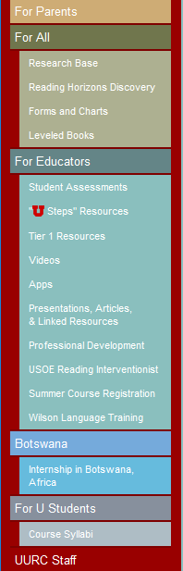
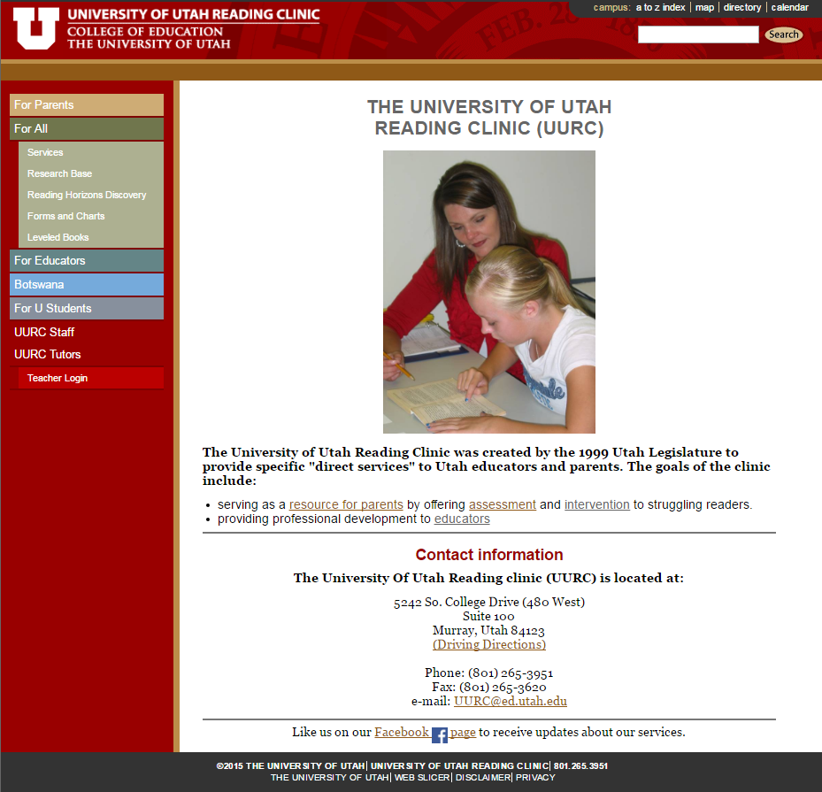
www.uurc.utah.edu
Handout

Slide 3

Our Mission
To provide quality professional learning and ongoing support so that educators have the skills and tools they need to help their students become fluent, independent readers, who are ready to explore the endless possibilities the world of reading has to offer.
Notes:
Speaker Notes:
We firmly believe all children can learn to read and write with expert instruction and our goal is to provide teachers with the tools and skills needed to carry this through. We solely concentrate on delivering high quality professional development services to teachers using their multisensory structured language curricula: the Wilson Reading System, Just Words and Wilson Fundations. In 1992, Wilson Language Training made teacher outreach, support and development the mission of the company. Wilson has worked with teachers across all 50 states to help close the gap for struggling readers and prevent reading failure by building a solid foundation for beginning readers.

Slide 4
Wilson Reading System®
Student Profile
Notes:
Speaker Notes:
Let’s first talk about who The Wilson Reading System is designed for.

Slide 5
Students with Dyslexia
(Language-Based Learning Disability)
80%
10-13%
7-10%
Notes:
© Wilson Language Training Corporation. All rights reserved.
5
Speaker Notes:
Statistics are somewhat varied on this, but here we present the average number of students from a school-age population. NICHD research indicates that all children benefit from phonological awareness and phonics teaching, however 20% require more exposure and 7-10% need intensive remediation - these are the students with dyslexia. These are the students who will benefit most from the Wilson Reading System, but the may or may not have a diagnosis of dyslexia.

Slide 6
Profile of a Wilson Student
Students with a language-based learning disability, such as dyslexia
Students in grades 2-12 and adults in lowest 30th percentile with decoding and spelling deficits
Slow, labored readers who lack fluency
Students who may know many words by sight, but have difficulty reading new words and “nonsense” syllables
Students who often guess at words
Students unsuccessful with other reading programs or who
have significant gaps in their decoding and/or spelling
Notes:
Speaker Notes:
Explain that WRS is appropriate for the students who do not have an internalized and quick and efficient system of word knowledge. It is for students in grades 2-12 who do not have sufficient decoding skills and are reading in the lowest 30th percentile.
Then quickly mention each bullet.

Slide 7
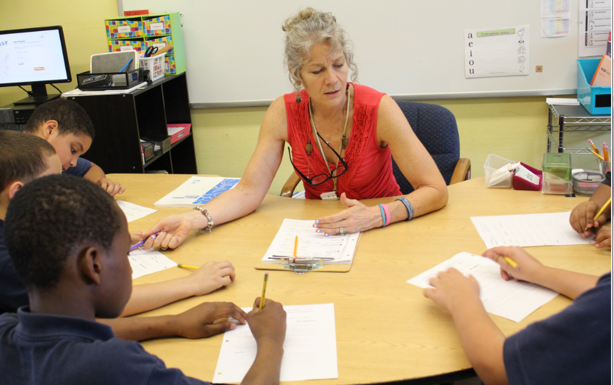
Wilson Reading System (WRS) Principles of Instruction
Notes:
Speaker Notes:
WRS is an Orton-Gillingham-based multisensory structured language instruction program. Let’s take a look at the Principles of Instruction for WRS.

Slide 8

WRS Principles of Instruction
Systematic: Sequential and cumulative word study
Mastery-based progression: Multiple opportunities to practice, feedback
Diagnostic Instruction
Explicit: Learning through modeling and doing
Multisensory / active learning
Metacognitive
Decoding & Spelling
Vocabulary, Fluency, & Comprehension
Notes:
Speaker Notes:
Explain that the teaching of structured language basics is done with these principles of instruction. These Principles of Instruction are key to WRS.
Systematic
Everything builds sequentially and cumulatively. The skills in each step of the program to build upon previously taught skills, presenting all new information explicitly.
Decoding > Spelling
Everything that is taught for reading is also taught for spelling along the way.
Explicit
Emphasize explicit instruction – WRS builds success, we do not want children to guess!
All learning involves active participation so students can learn through various modalities. Active participation also helps maintain students' focus. Manipulatives – quickly show audience sound cards, magnetic tiles, and syllable and word cards.
Multisensory
Includes gross motor and tactile skills such as tracing, tapping
multisensory teaching approach. (Teaching is done using all learning pathways in the brain (visual/auditory, kinesthetic-tactile) simultaneously in order to enhance memory and learning.
Mastery-Based
Students have ample opportunity to apply these skills for reinforcement. Skills are presented in a variety of ways and modalities. Children, especially those with difficulty, need lots of repetition Good news is kids LOVE this!
Feedback- is immediate. Interactive…students always get feedback immediately. If there is an error, teachers correct it with a question, or explain, and give students an opportunity to do another example.
Metacognitve
Students are developing an awareness of what they know and this is demonstrated in each lesson through teacher questioning, marking of language concepts, and the development of self-monitoring.
Let’s talk a little more about some of these instructional components.

Slide 9
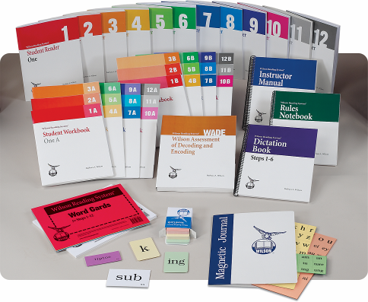
The Wilson Reading System
12-Steps
Notes:
© Wilson Language Training Corporation. All rights reserved.
9
Speaker Notes:
WRS is research-based and it is presented to students in 12 sequential steps (not related to grade level). Generally, it takes 2-3 years to complete all 12 WRS Steps if scheduled and implemented with fidelity.

Slide 10
WRS Scope & Sequence
Throughout 12 steps, students work on fluency, vocabulary, and comprehension.
Steps 1-6 Consistent Patterns to Establish Solid Foundation
  closed syllable
  v-e syllable
  open syllable
  -le syllable
  suffixes
  multisyllabic words with taught patterns
Steps 7-12 More Complex Concepts and Morphology
  sound options, contractions
  r-controlled syllable
  vowel digraph-diphthong “d” syllable
  suffixes to changing basewords
  advanced concepts
Notes:
Speaker Notes:
Without going through what is taught in every step you can see from this chart the sequence that WRS follows for teaching word structure.
The six syllable types are taught over time, across many steps.

Slide 11
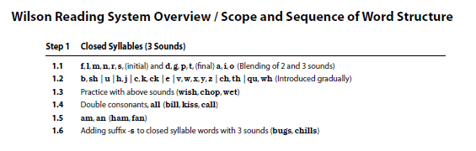
Instructor Manual: Scope & Sequence
Notes:
Speaker Notes:
To show you how detailed the instruction in language structure is, here you see that each of the 12 steps are further broken down into substeps which address specific decoding/encoding skills and the specifics of the English Language Structure.

Slide 12
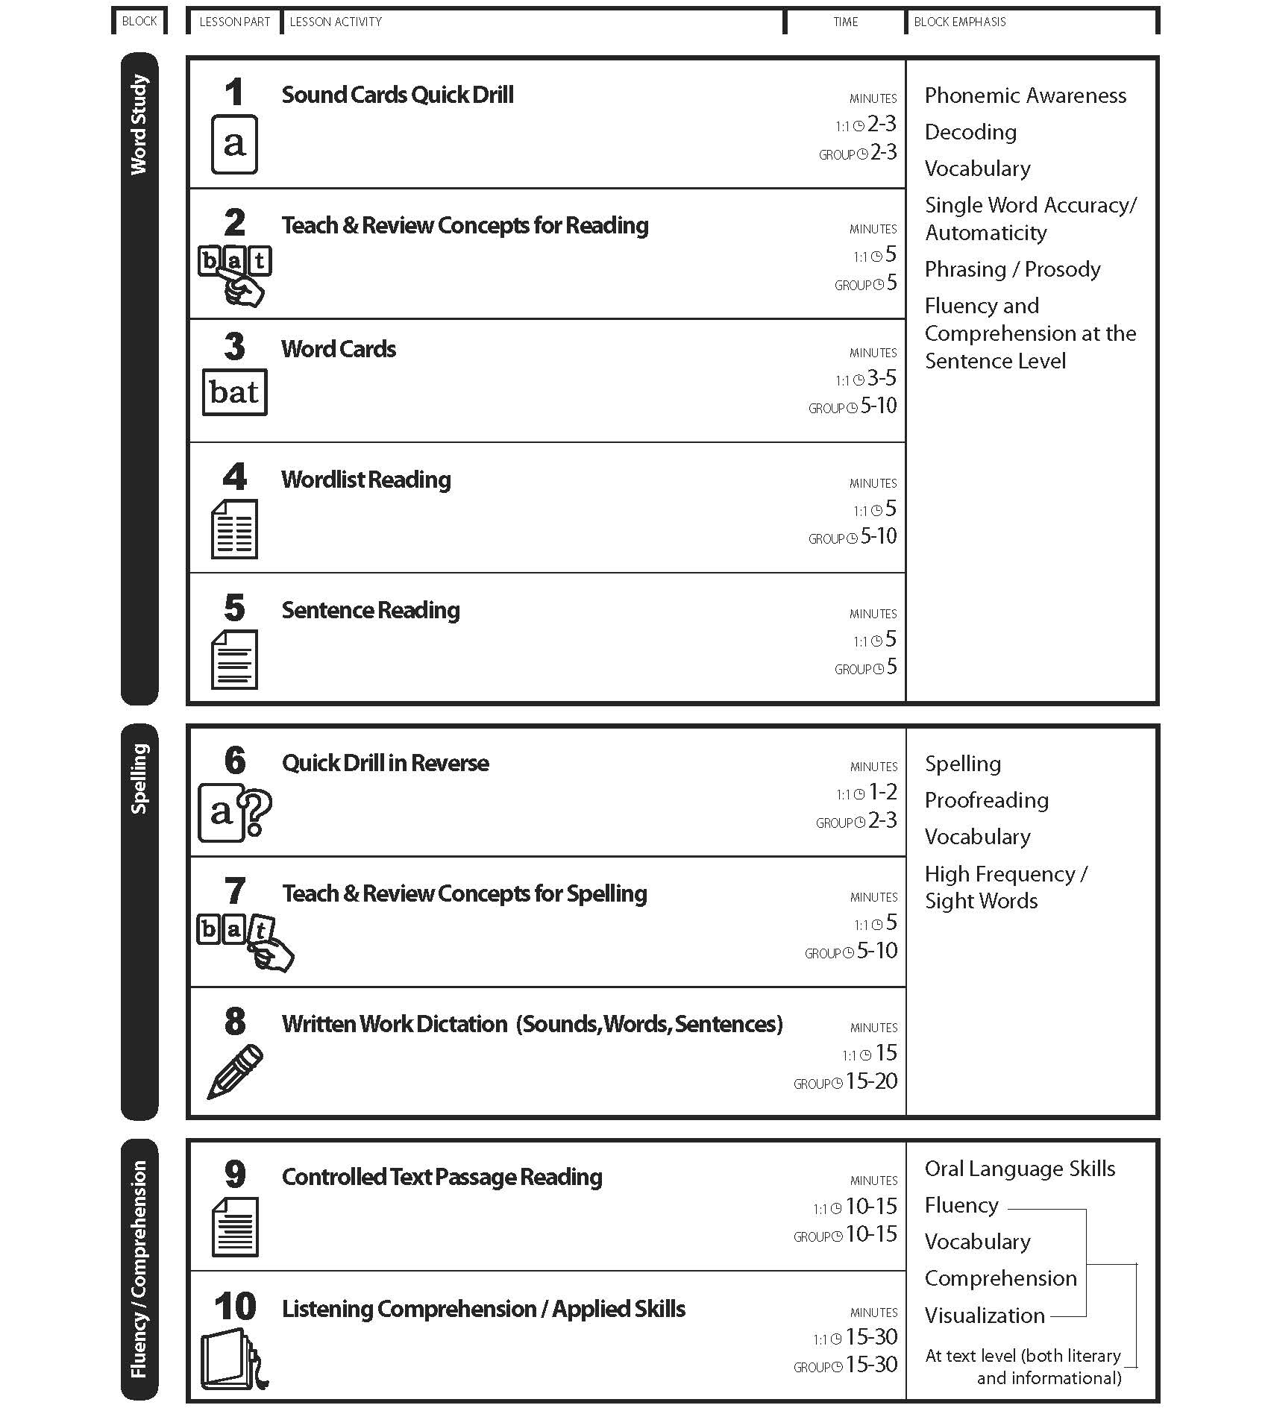
WRS Ten-Part Lesson Plan Outline
BLOCK 1
BLOCK 2
BLOCK 3
Notes:
Speaker Notes:
WRS has a standard lesson with 10 parts:
Word Study Block 1 = Lesson Plan Parts 1 – 5: The emphasis is on phonemic awareness, phonics, accuracy and automaticity reading words in isolation, and the study of selected vocabulary words. Controlled sentences are used to practice applying the learned phonics skills, develop comprehension skills, and model and practice fluent oral reading.
Spelling Block 2 = Lesson Plan Parts 6 – 8: The emphasis is on the reinforcement of phonemic and phonic skills through spelling. Students manipulate sounds and spell words. Students also write from dictation and develop precise proofreading procedures.
Fluency/Comprehension Block 3 = Lesson Plan Parts 9 - 10: The emphasis is on working with connected text (both literary and informational passages) to develop a student’s oral language skills, fluency, vocabulary, comprehension, and visualization. During this block students work with controlled text, enriched text and decodable text (narrative and informational).
It takes 60-90 minutes to complete a full WRS Lesson. Scheduling for 1:1 and small group instruction may differ slightly, but the goal should be to complete 2 – 3 FULL WRS lessons with a student or group of students each week. Not properly scheduling lessons will impact student progress in a negative way.

Slide 13
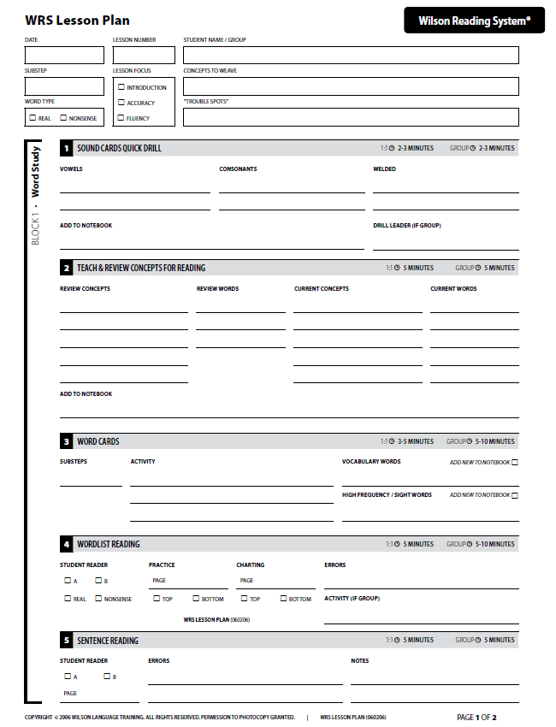
Diagnostically Planned Lessons
Notes:
Speaker Notes:
All lessons (1:1 or group) are diagnostically planned and delivered. Teachers plan out each lesson using the WRS Lesson Planning Resources such as the Instructor Manual and Dictation Book. Diagnostically planned lessons are key to get the student outcomes your are looking for.

Slide 14
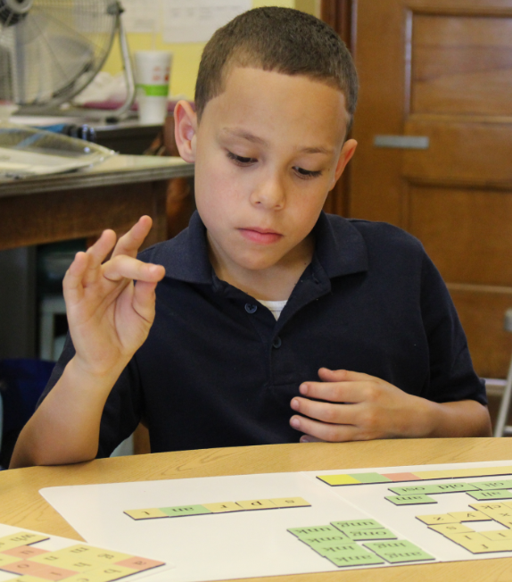
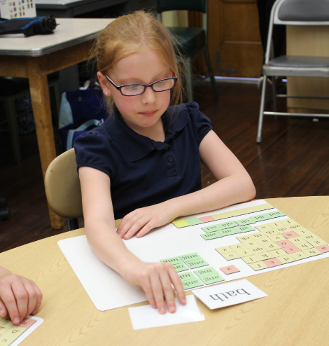
Multisensory: Visual-Auditory-Kinesthetic-Tactile
Card and Tile Manipulation
Tapping (phoneme segmentation and blending)
See – Say – Write
Scooping for phrasing/prosody
Tracing and Skywriting
Notes:
14
Speaker Notes:
In WRS, teachers use a variety of materials and strategies to make every part of the lesson multisensory and interactive.
This type of instruction is beneficial to all students, and is essential to these students who have significant reading deficits and/or a language-based learning disability such as dyslexia.

Slide 15
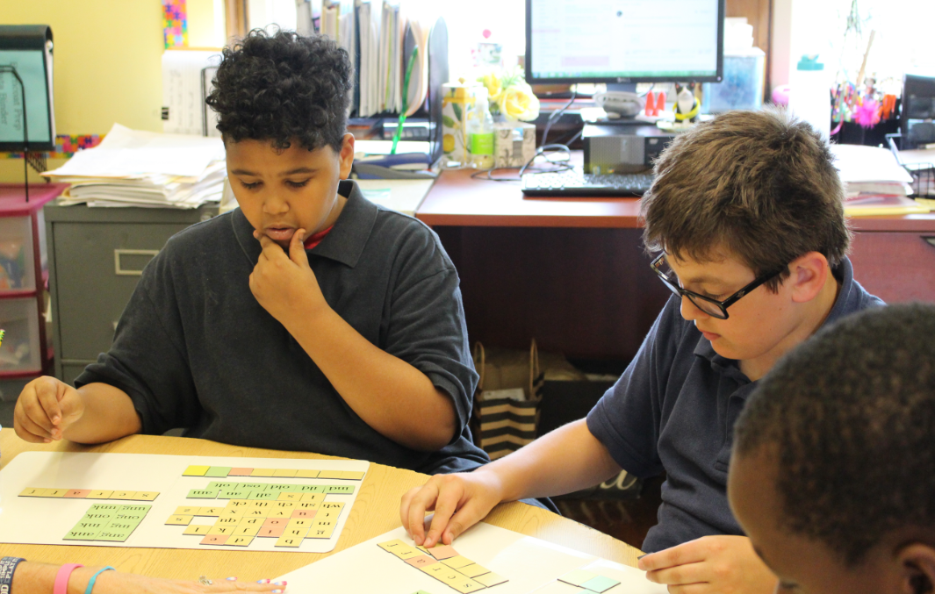
Metacognition
Students learn how to decode and spell words
They verbalize what they do in order to succeed
“Know what they know” and how to apply it
Knowing the Why
Notes:
Speaker Notes:
We teach students to understand why they are learning certain concepts and/or strategies – knowing “why” is part of metacognition.
Metacognition is the ability to know, understand, and explain what you are doing and why (i.e. when a student makes an error, they should explain what they did to decode the word).
Example:
Explain to students that focusing on small units of sounds in one syllable words prepares them to separate longer words into syllables fast and efficiently.

Slide 16
Focus on Instruction for Students with Primary Decoding Deficit
WRS Instructional Goals
Accuracy & Automaticity: Phonemic Awareness & Phonics
Develop accurate and speedy word recognition
Fluency
Develop independent reading of connected text with ease, expression and meaning
Vocabulary & Comprehension
Develop vocabulary and background knowledge and listening comprehension
Notes:
Speaker Notes:
Students who do not decode need to learn how to decode. However, instruction must not be limited to basic decoding. Students must also achieve speedy word recognition, fluency, vocabulary, and comprehension.
Thus, these are the goals of your Wilson instruction. (No need to read.)

Slide 17
Word Study
c
a
p
pre
tend
beagle
Notes:
Speaker Notes
Let’s talk more specifically about developing word level skills.

Slide 18
Word Study
Two Types of Words
Phonetically Regular (Controlled)
High Frequency Words (includes irregular)
lash
what
slash
was
mascot
her
Notes:
Speaker Notes:
WRS instruction focuses on two types of words to learn (phonetically regular words and high frequency words). Discuss examples of these words and be sure audience understands the difference.

Slide 19
Phonetically Regular Word Study
a
Sound/Symbol Relationships
Blending & Segmenting
b
a
g
Syllable Structure
fan
tas
tic
Word Parts
re
gret
ful
Notes:
© Wilson Language Training Corporation. All rights reserved.
19
Speaker Notes:
Wilson very explicitly teaches all about phonetically regular words. Give one brief explanation here, don’t give too much detail. We want students to become automatic and move from individual sounds to blend them into orthographic units, syllables and words, and then basewords, prefixes and suffixes. Explain that we directly teach word structure, starting with letter names and individual sounds. We teach sound blending for reading and sound segmenting for spelling. Then students move on to syllable segmentation and word parts like basewords and suffixes. As you can depicted on this slide, everything is taught with manipulatives (cards).

Slide 20
Teach Sounds to Automaticity
Sound Mastery
1:1 letter sound correspondence most frequent sound of consonants, long and short vowel sounds
  -production of sound
  -association of grapheme to sound
a
b
c
d
e
f
g
h
i
j
k
l
m
n
o
p
qu
r
s
t
u
v
w
x
y
z
wh
ch
sh
th
ck
Notes:
Speaker Notes:
Briefly describe that in WRS, we do teach letters and sounds from the first lesson. We introduce the letter name and sound together, using a keyword and work toward automaticity. For example:
a - apple - /a/
b - bat - /b/
Say that we teach that digraphs have two letters but only one sound: sh - ship - /sh/

Slide 21
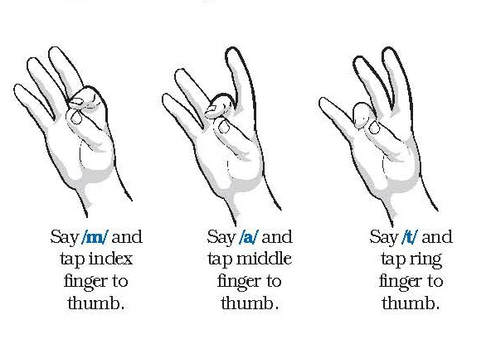
Word Study
Teaching students to blend phonemes with letters (graphemes) helps them to decode.
m
a
t
Notes:
Speaker Notes
We teach students how to tap if they cannot decode a word that they see. We start with three sounds. There seems to be a neurological link that occurs by touching one’s thumb to one’s fingertip to help blend the sounds together.
We use tapping for reading and spelling. Demonstrate each. Have participants practice.

Slide 22
Syllable Types
Closed Syllable
drip
c
Vowel-Consonant-e Syllable
brake
v-e
she
Open Syllable
o
ta ble
Consonant-le Syllable
o
-le
bark
R-Controlled Syllable
r
boat
Vowel Digraph/Diphthong Syllable
d
Notes:
Speaker Notes:
Emphasize that we always scoop or underline the syllable first to indicate that the group of letters form the syllable. Then we identify the kind of syllable and that tells us about the vowel sound.

Slide 23
Closed Syllable
s
m
a
t
Has only one vowel
Vowel is followed by one or more consonants (closed in)
The vowel is short
sh
m
e
m
e
a
t
i
t
m
a
t
e
l
i
sh
Notes:
© Wilson Language Training Corporation. All rights reserved.
23
Speaker Notes:
How many people are familiar with closed syllables? If you are, you will see how we teach it in Wilson, if you are not, don’t read the definition, first watch how we teach students about it, then we will look at the definition.
Slide created so all can see manipulation in large room, otherwise first do with cards. Use it to explain HOW we teach syllable recognition with manipulation of cards.
Say that you won’t be able to do all syllable types with cards, but that it is key to the program and important to see how we teach everything with this manipulation which makes a tremendous difference to students. The closed syllable is taught first. It is the most common (more than 40% of syllables are closed).
1. The sound cards a and t appear to show simplest closed syllable, 2 sounds.
2. m appears in front of at for mat
3. The t of mat changes to sh for mash.
4. An s appears in front of mash to make smash to show 5 sounds, 6 letters in a closed syllable.
5. For the next examples, ask is this a closed syllable?
me appears, ask if it is a closed syllable, then ask what would you have to do to make it a closed syllable? Click and the t appears to make met
meat appears, ask same questions, click and the a is crossed out
mate appears, ask same questions, click and the e is crossed out
lish appears to show an example of a nonsense closed syllable
There are 6 syllable types in English. WRS 12 steps are based on the 6 syllable types.
Read and discuss definition, how impossible it would be for students to apply this if taught with words (or language only) – especially since the students who need this have difficulty with language.

Slide 24
Systematic Sequence of Skills
l
a
sh
s
l
a
sh
s
l
u
m
p
s
c
r
i
p
t
Notes:
© Wilson Language Training Corporation. All rights reserved.
24
Speaker Notes:
This step by step approach is necessary for students to really internalize things. Students must demonstrate proficiency before moving on.

Slide 25
Syllable Instruction is Cumulative
Combine syllables for multisyllabic words
pub
lish
Teach new syllable type in isolation
r
i
d
e
and then combine with other types already studied.
ath
lete
Notes:
© Wilson Language Training Corporation. All rights reserved.
25
Speaker Notes:
Explain that before we teach another syllable type, we start to put syllables together to make longer words.
Point out briefly that we scoop syllables to read.

Slide 26
Wilson Word Structure
Decoding
(Reading)
Encoding
(Spelling)
Vocabulary
Notes:
Speaker Notes:
Many programs do not include spelling. Not only does WRS teach spelling, you are teaching it in correspondence to the decoding patterns that are taught. This reinforces what has been taught for reading, and vice-a-versa. In addition, there is at strong emphasis on vocabulary. This is critical to developing strong comprehension skills.

Slide 27
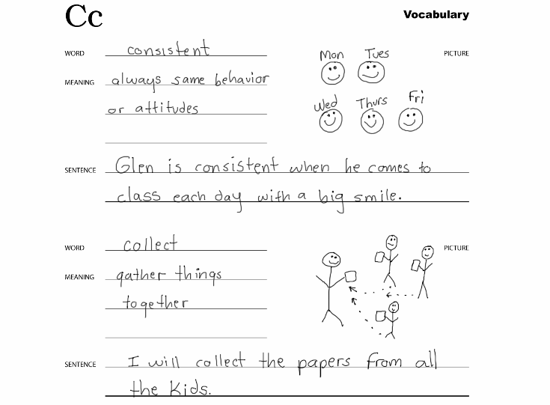
Direct Vocabulary Instruction
v
consistent
Notes:
Speaker Notes:
Explain that the selected words are added with simple definitions in student friendly terms as well as illustrations to a student notebook and a sentence (don’t go into detail).
Teachers put vocabulary words on word cards for practice and keep track of the lists in theirTeacher’s Planbook so that these words can be integrated into lesson plans.

Slide 28
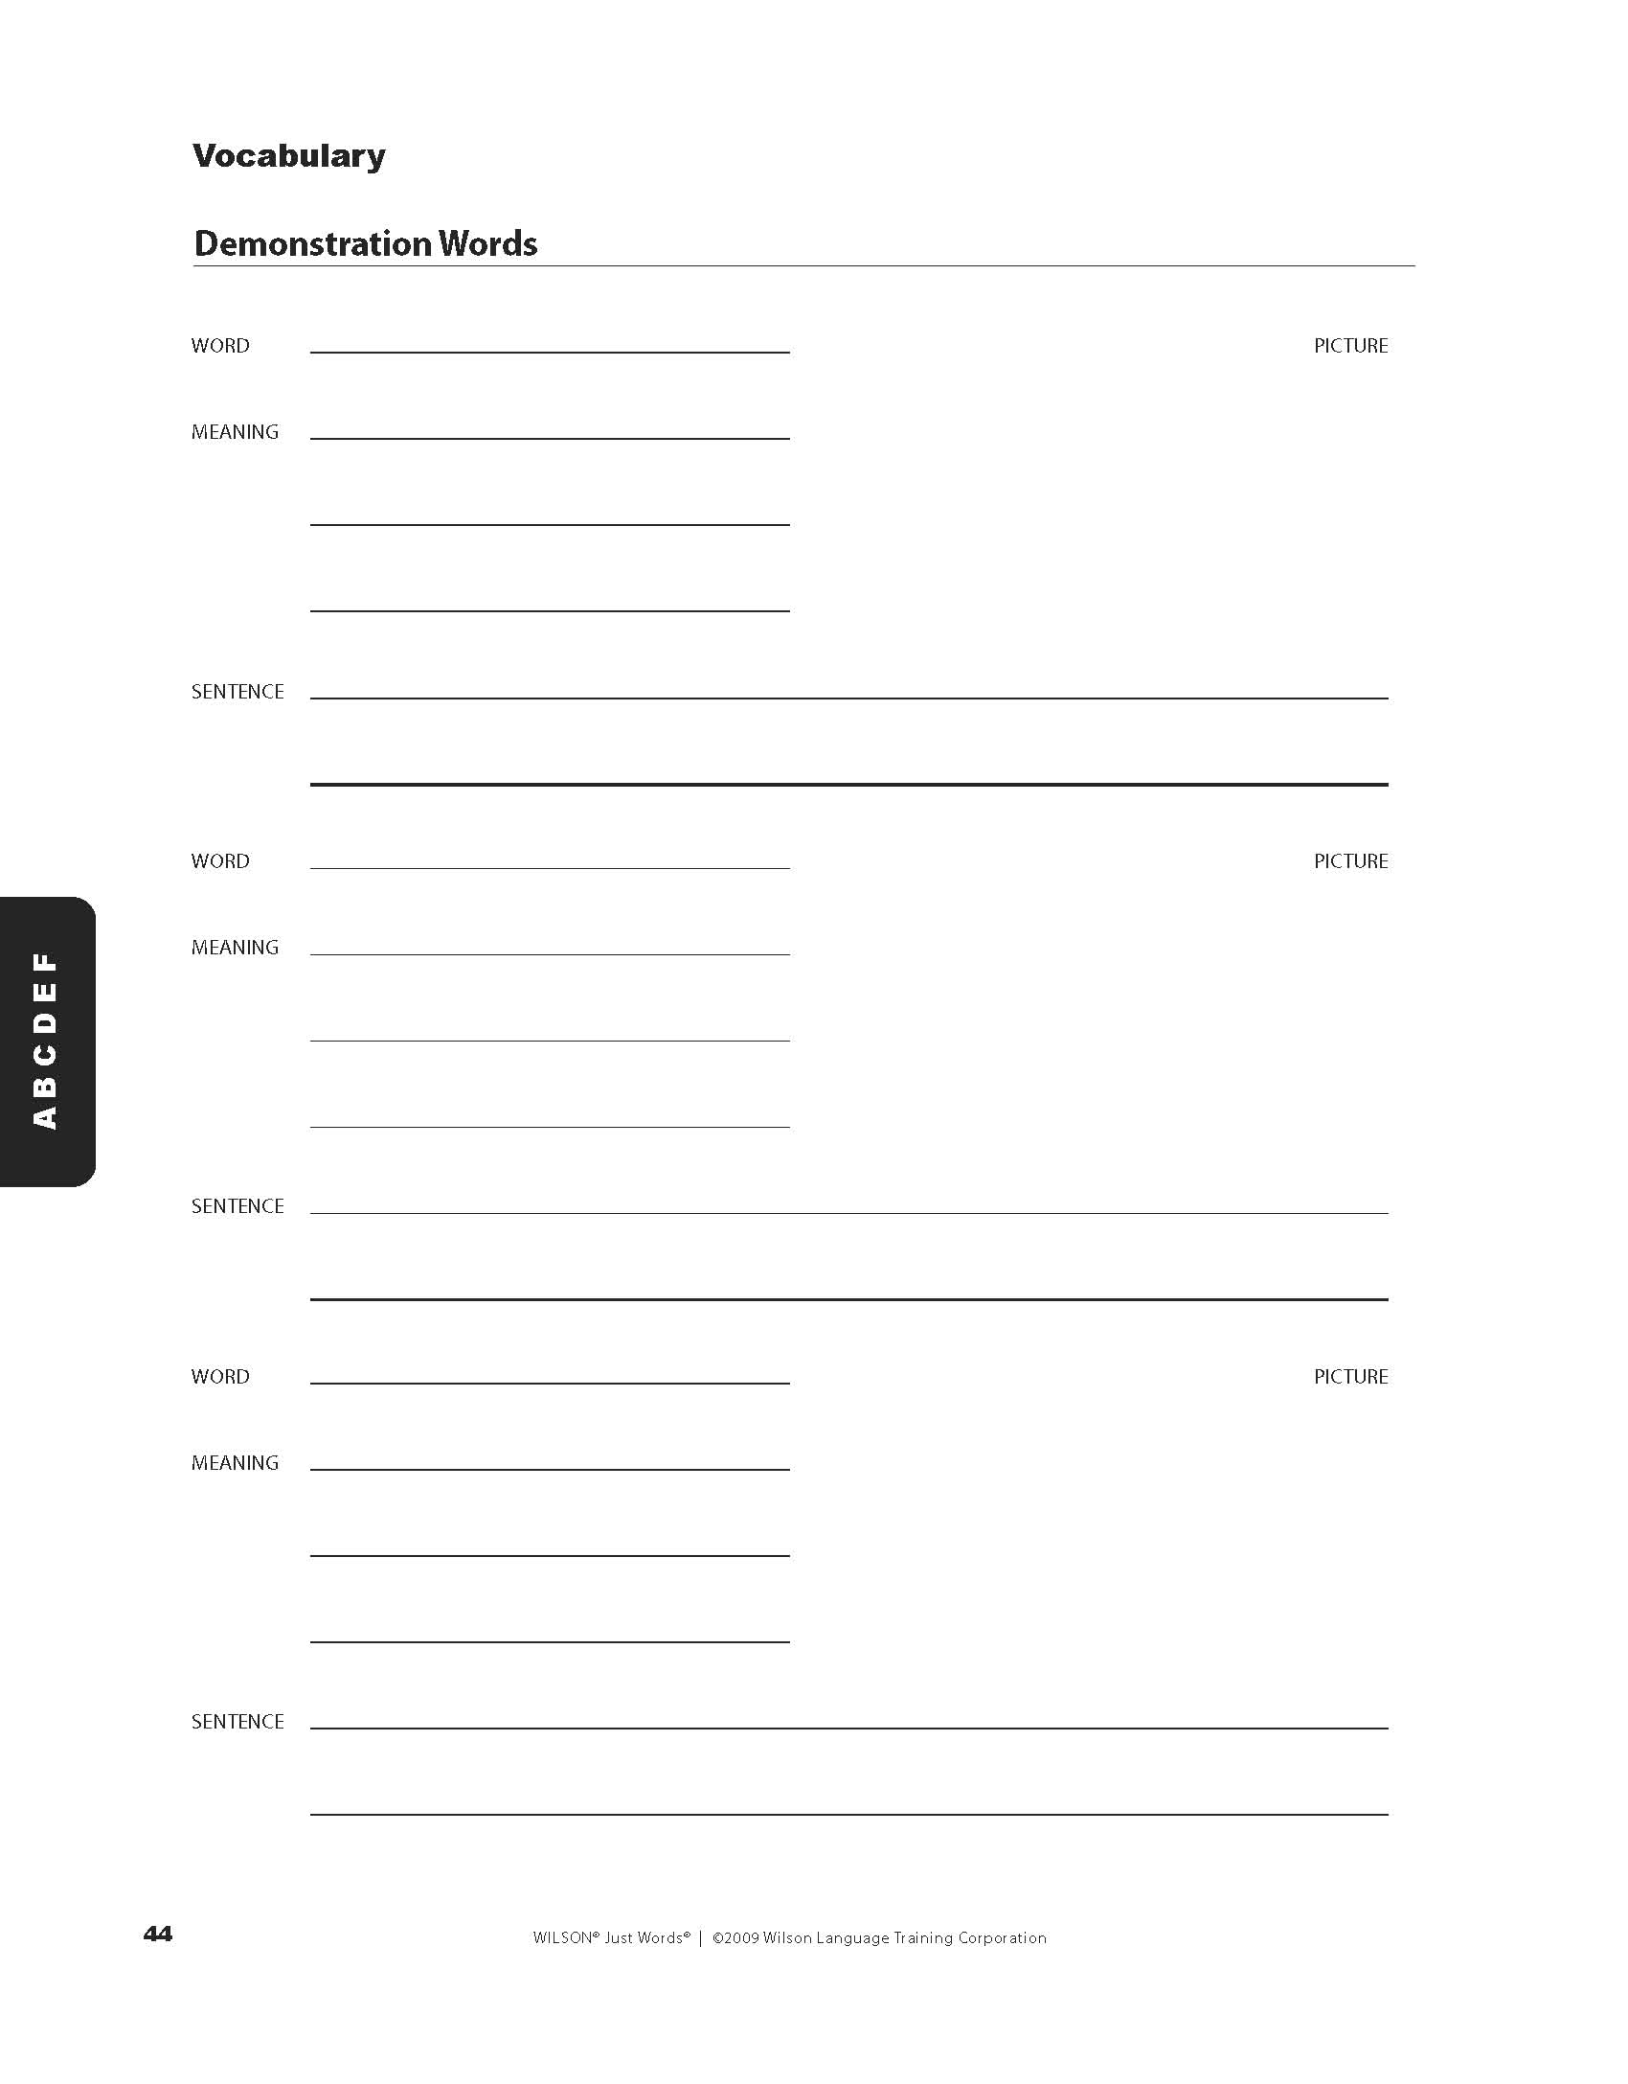
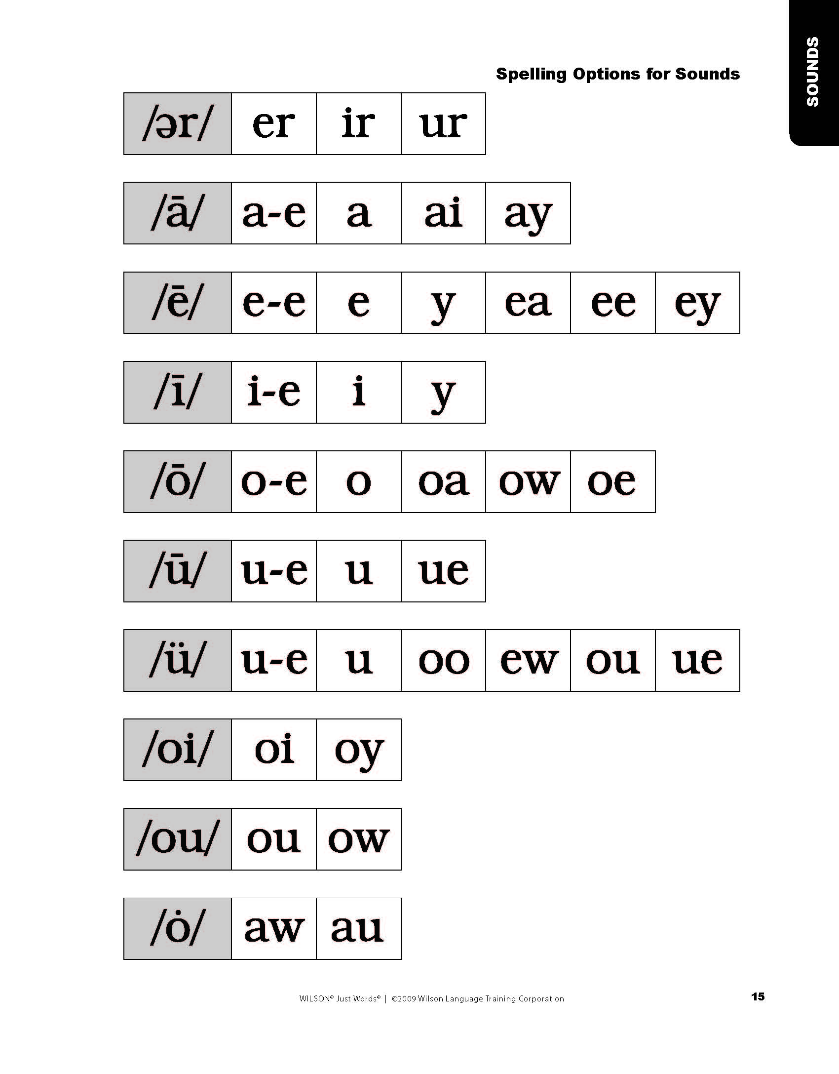
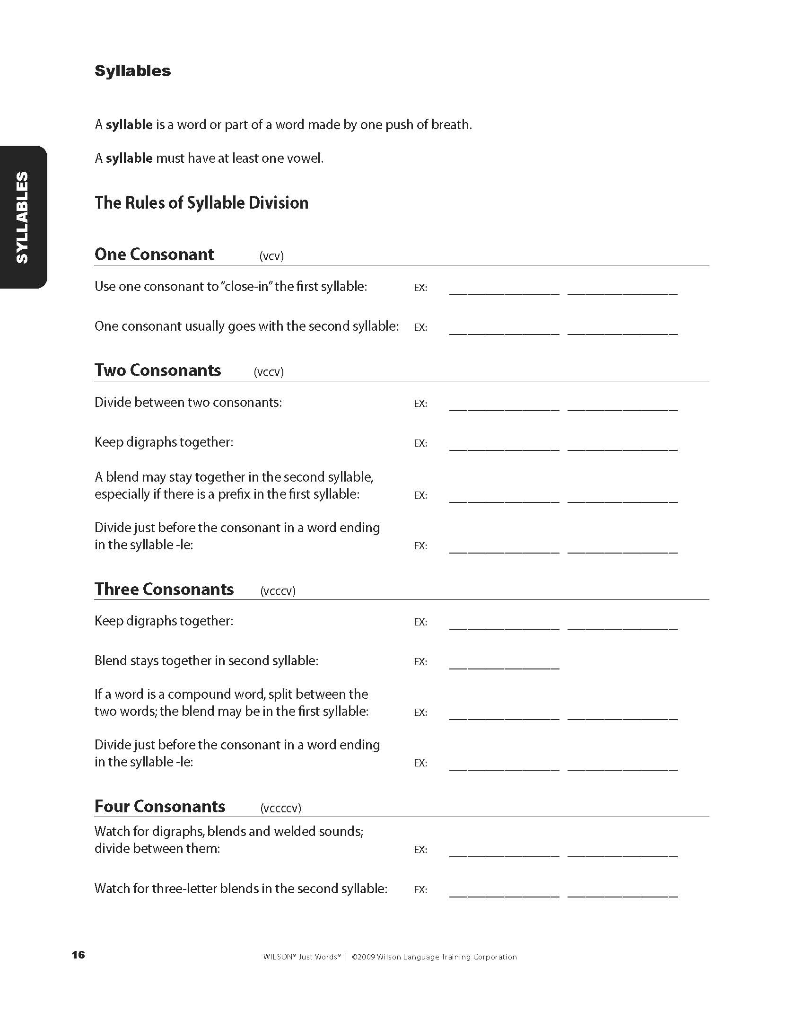
Student Notebook
Students develop a notebook for reference
  Sounds
  Syllables
  Spelling Rules
  Vocabulary
  High Frequency Words
  Vocabulary and High Frequency Words sections are alphabetized to reinforce dictionary skills
Notes:
Speaker Notes
I just mentioned the notebook. In addition to adding vocabulary, the Student Notebook is used by all WRS students and is a place for students to document all letters/sounds, spelling rules, syllable types, targeted vocabulary words, and HFSW words learned. The Student Notebook is used in each lesson and is available for WRS students to reference at any time.

Slide 29

WRS Focus on Fluency: Connected Text
Direct instruction and guidance to develop rate and prosody
Wilson uses a scooping technique to provide a graphical representation of phrasing
Jim has a job at the Esquire Pancake Shop.
A bad kind of fish is on the run.
Notes:
Speaker Notes:
For both controlled and non-controlled decodable passage: we develop fluency with phrasing, or prosody.

Slide 30

Fluency Instruction
Decodable Text
Controlled Decodable Text
Non-Controlled Decodable Text
(authentic)
Notes:
Speaker Notes:
Fluency instruction includes two types of decodable text: controlled and non-controlled text. Explain the difference and importance of both for WRS students.

Slide 31


Extensive Practice with Controlled Text
WRS Student Readers
Notes:
Speaker Notes
Let’s take a look at the extensive controlled text provided in the WRS materials.

Slide 32
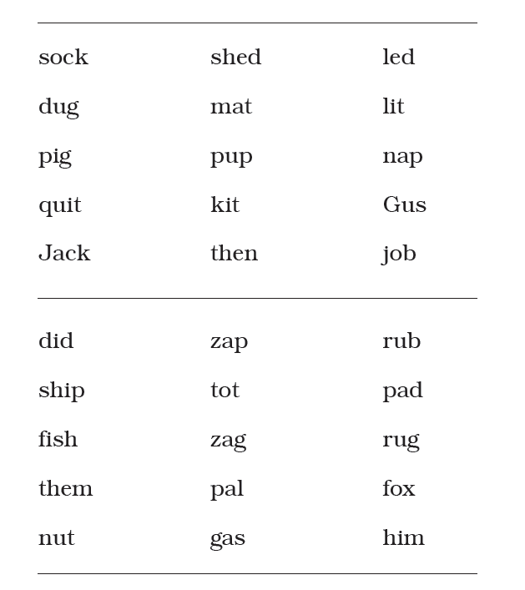
Controlled Text: WRS Student Reader – Step 1.3
Notes:
Speaker Notes
There are several examples of controlled text on the next 15 or so slides. There is no need to show all of them if time is limited, but it is a nice example of how student progress to more complex word structure and how that looks with sentences and passages. You can explain what has been taught thus far as you click through the slides, but in general you will probably not spend much time on each slide.

Slide 33
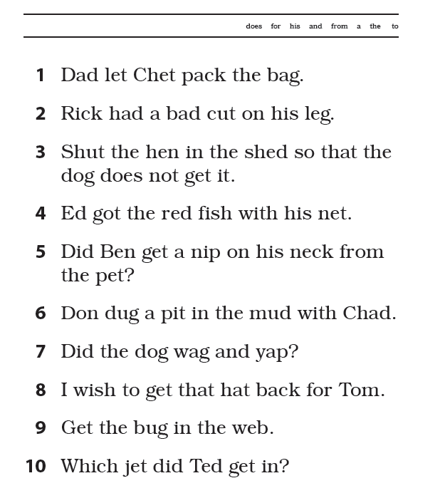
Controlled Text: WRS Student Reader – Step 1.3

Slide 34
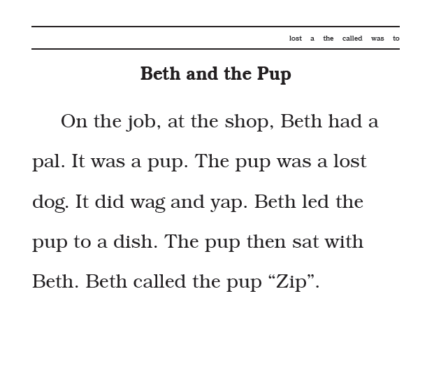
Controlled Text: WRS Student Reader – Step 1.3

Slide 35
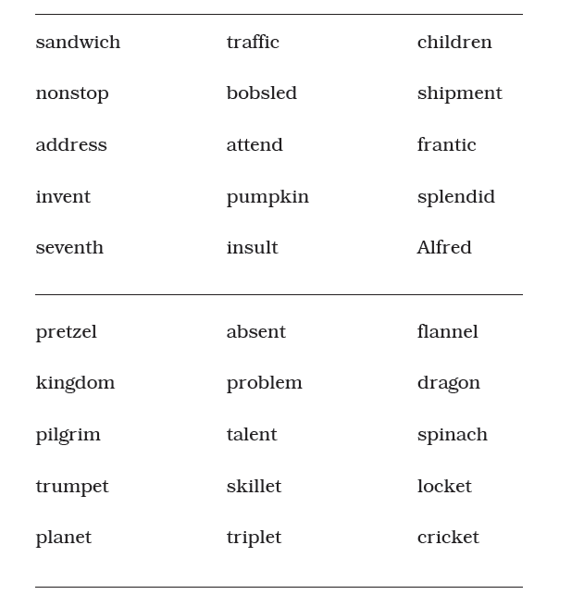
Controlled Text: WRS Student Reader – Step 3.2

Slide 36
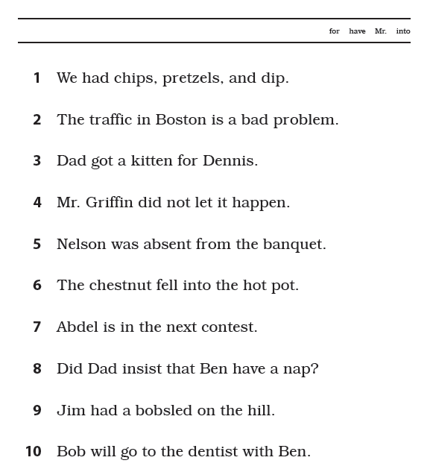
Controlled Text: WRS Student Reader – Step 3.2

Slide 37
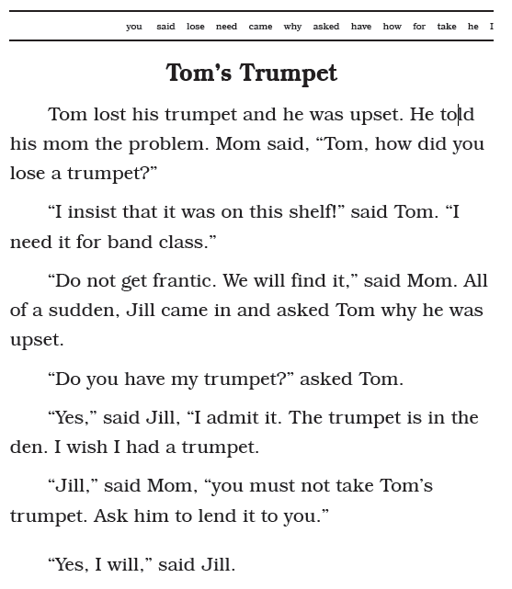
Controlled Text: WRS Student Reader – Step 3.2

Slide 38
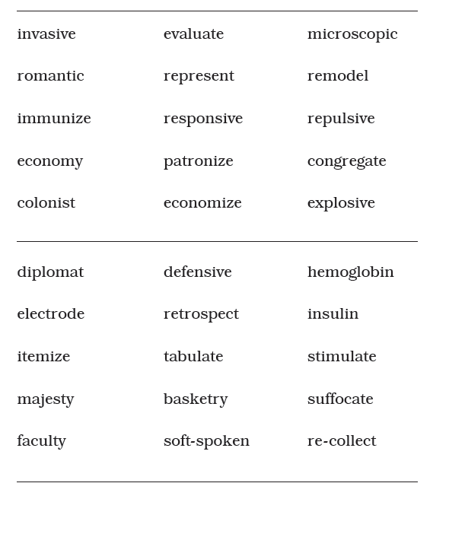
Controlled Text: WRS Student Reader – Step 5.4

Slide 39
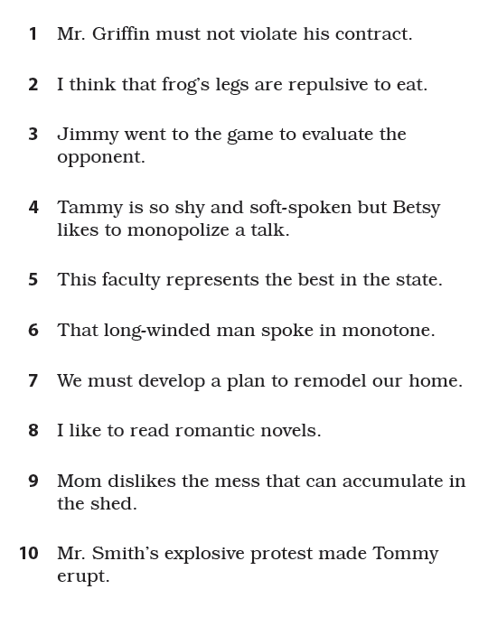
Controlled Text: WRS Student Reader – Step 5.4

Slide 40
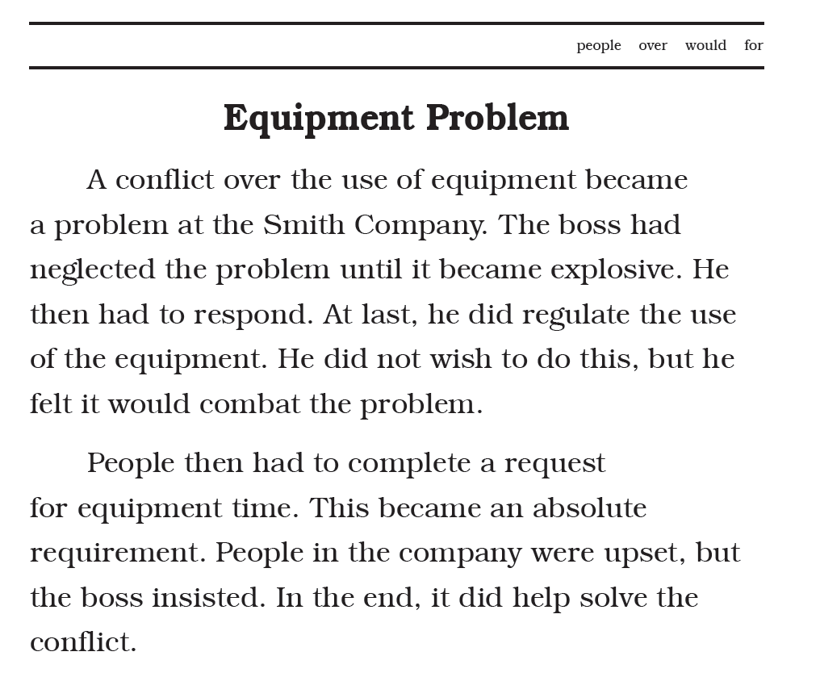
Controlled Text: WRS Student Reader – Step 5.4

Slide 41
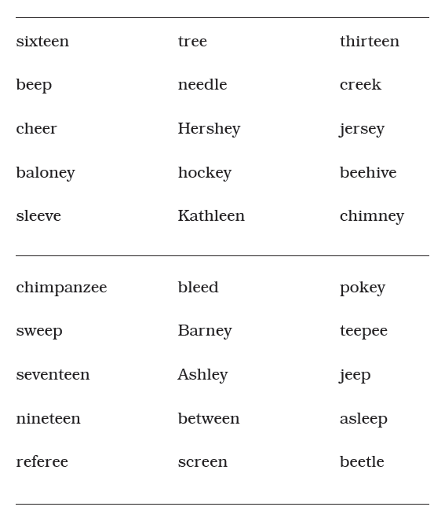
Controlled Text: WRS Student Reader – Step 9.2

Slide 42
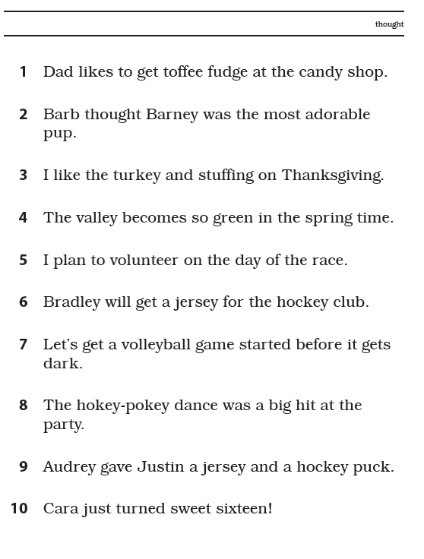
Controlled Text: WRS Student Reader – Step 9.2

Slide 43
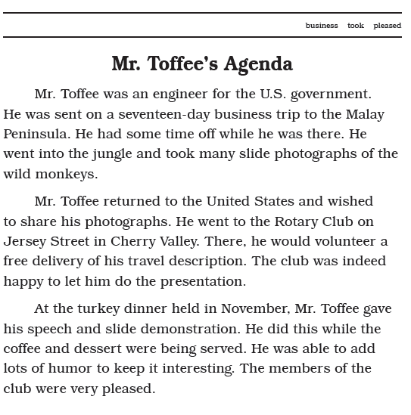
Controlled Text: WRS Student Reader – Step 9.2

Slide 44
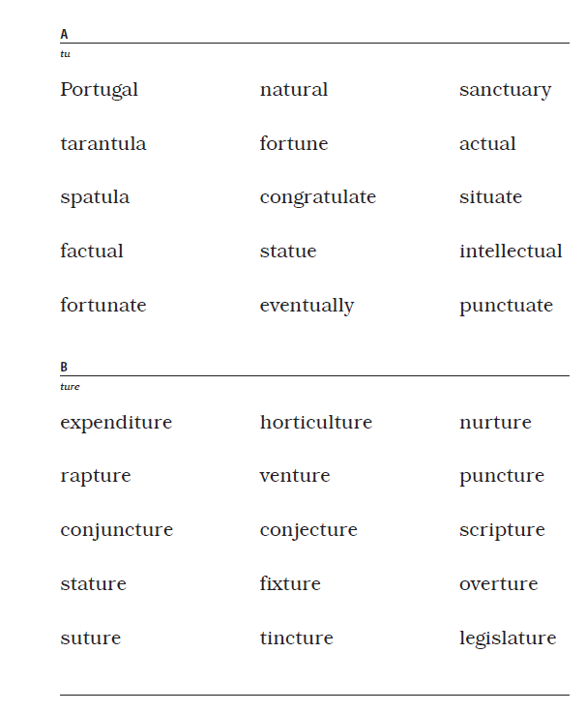
Controlled Text: WRS Student Reader – Step 12.5

Slide 45
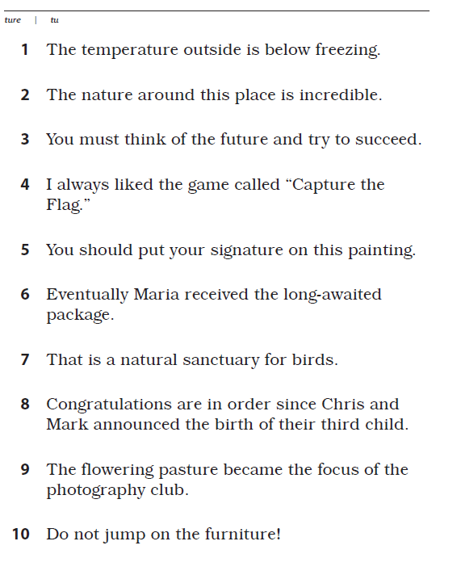
Controlled Text: WRS Student Reader – Step 12.5

Slide 46
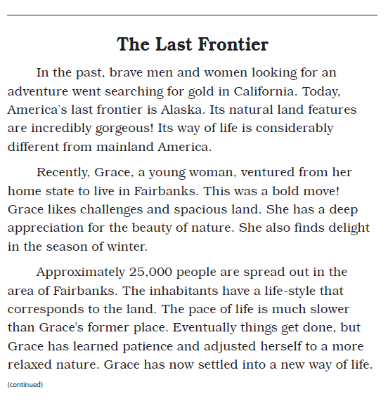
Controlled Text: WRS Student Reader – Step 12.5

Slide 47
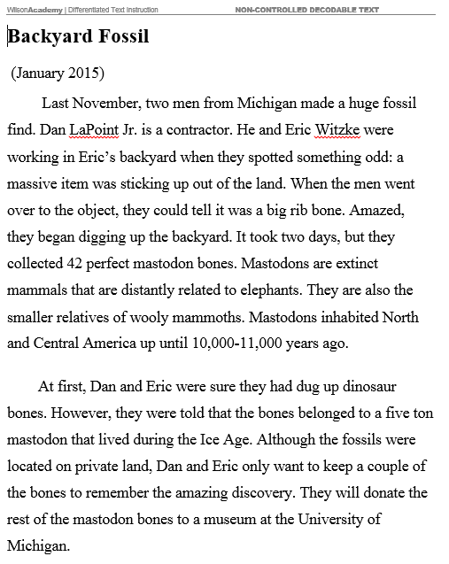
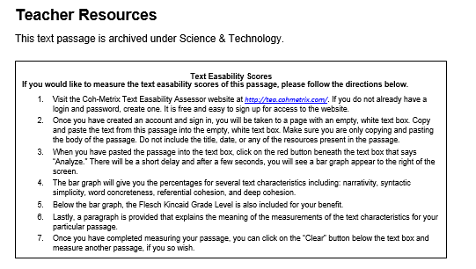
Non-controlled Decodable Text

Slide 48


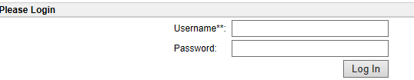
Non-controlled Decodable Text

Slide 49
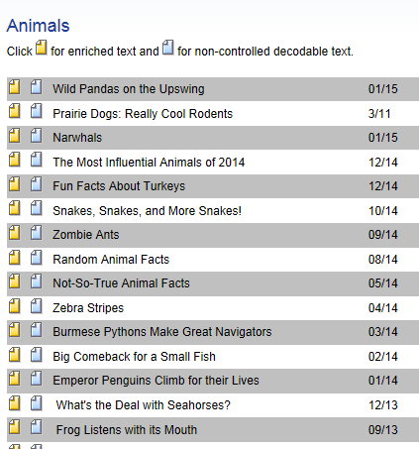
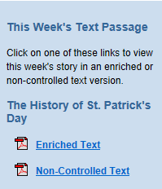
Weekly Passages & Archived Library

Slide 50
Wilson Comprehension S.O.S.™
SCAFFOLD/SUPPORT
S.O.S.
=
STOP
-
-
ORIENT
Reread and elicit discussion at appropriate interval.
Elicit and explain vocabulary using student-friendly definitions, model thinking.
Create imagery, help student to picture story, referring to wording of text.
Draw pictorial representation of content referring to wording of text (as needed).
Have student replay visualization and rehearse a retelling of the passage.
Have student retell story in detail and proper sequence, model as needed.
Have students identify areas of confusion – monitoring
Notes:
Speaker Notes:
Briefly explain that this comprehension strategy is used for developing a student’s coherent mental model during reading and listening comprehension.

Slide 51
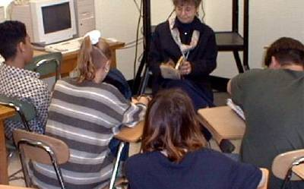
Comprehension Instruction
Listening Comprehension
Narrative and informational text at higher level than accessible to students at their independent reading levels
Reading Comprehension
Wilson controlled text
Wilson non-controlled decodable text (from Wilson Academy)
As students progress – provide other narrative and informational text at students’ independent reading level
Notes:
Speaker Notes:
We work with comprehension (reading and listening comprehension) from the beginning with vocabulary work and visualization.
Initially, the teacher should read literature and then expository text to the students. As they progress with their skills, they should begin to read more and more independently.

Slide 52


Controlled Text Passage Reading
PART
9
Objectives:
To provide opportunity for students to practice fluent decoding skills with controlled text.
To develop comprehension through visualization.
To develop oral expressive language skills
Notes:
Speaker Notes:
The comprehension work for WRS Students occurs in Parts 9 and 10 of the lesson
We are working on many things here, but our main objectives are:
To provide an opportunity to apply decoding skills to connected (controlled) text.
To develop comprehension of a short passage through visualization techniques.
To develop oral expressive language skills through replaying and retelling of passage.

Slide 53
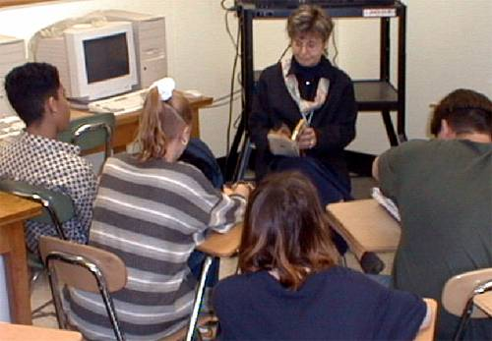
Listening Comprehension / Applied Skills
PART
10
Listening Comprehension:
“Read Alouds” – teacher reading and modeling prosody, etc.. – teacher demonstrates S.O.S.
Applied Skills:
Interactive Reading – guided reading / teacher led, but student(s) doing part or all of the reading (can be teacher and student taking turns) S.O.S. done with student
Independent Reading – students read on their own (also do S.O.S. on their own)
Notes:
Speaker Notes:
Everything that we just discussed in Part 9 is critical in Part 10. Visualization, Replay/Retell, and Comprehension S.O.S. are all done just like with Part 9. The difference now will be with the text that is being used. Part 10 is listening comprehension at first and you will just be doing enriched text (literary then informational text), reading to them. You do not want to introduce them to non-controlled text immediately. First, you are going to read to them. And, what do we know happens to the kids that can’t read themselves? They are missing out on vocabulary, background schema, knowledge, etc.
And then as we progress through the steps of WRS, it is also applied skills (Click) with non-controlled decodable text during Part 10 of the lesson.
(Click) At first you can do this in an “interactive” way where the teacher and students are taking turns reading. Then – students read independently – applying comprehension strategies.

Slide 54
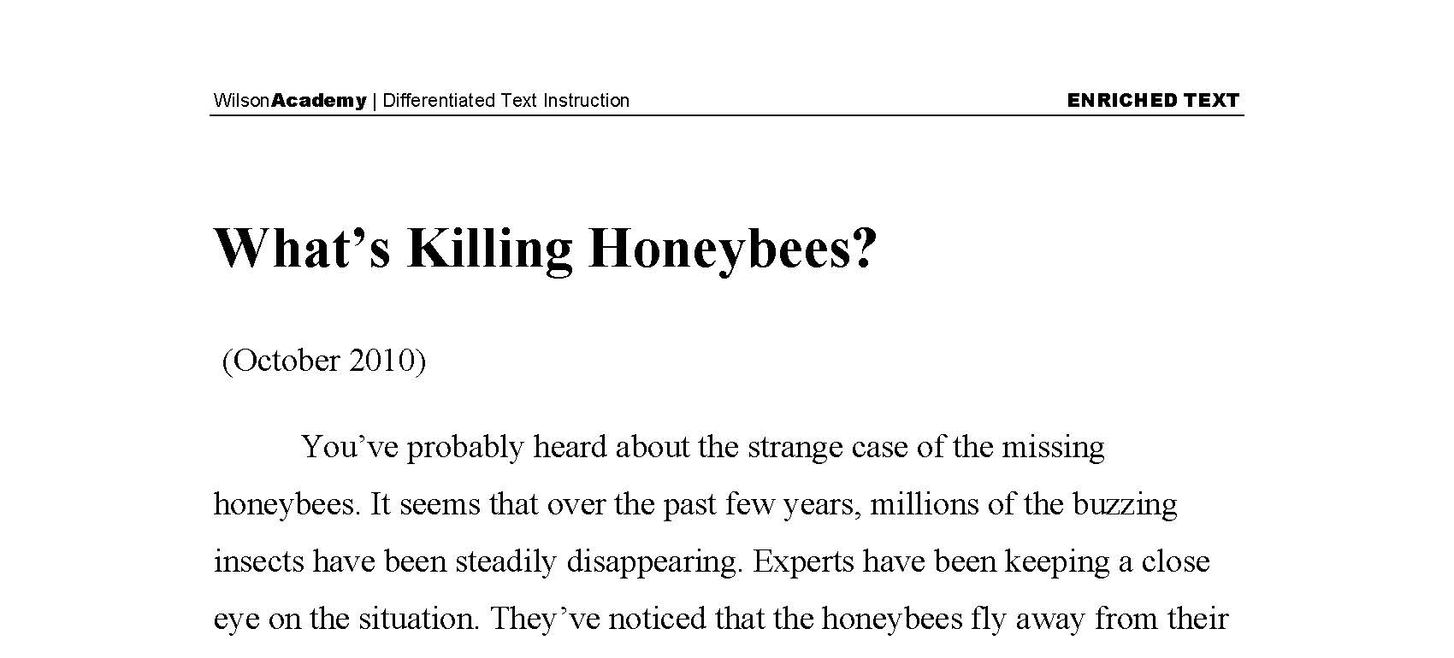



Comprehension: Informational & Literary Text
Notes:
Speaker Notes
Literary (narrative) and informational text work is key to students developing the skills they will need as they move into secondary education settings.

Slide 55

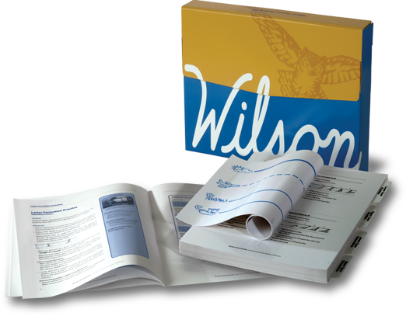
…and more, if needed
Wilson Fluency Basic®
Wilson Cursive Writing®
Notes:
Speaker Notes
For Wilson Students needing additional work on fluency, teachers can also implement the use of the Wilson Fluency Basic program and Wilson offers a cursive handwriting program for students if that is an area needing direct instruction.

Slide 56

Identifying Authentic WRS Instruction
Implementation & Teacher Training
Notes:
Speaker Notes
Now let’s discuss how to identify if factors for proper implementation, instruction, and teacher training are in place.

Slide 57


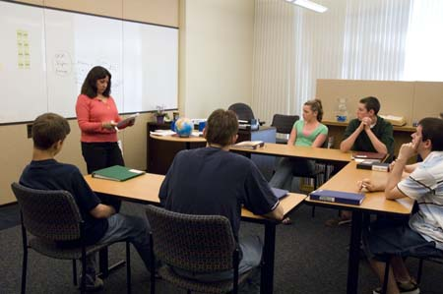
WRS Intensive Instruction (Grade 2 – 12, Adults)
1:1 Instruction
2 – 6 Students in Small Group Instruction
Notes:
Speaker Notes:
This WRS program is appropriate for students with the most intensive needs including those diagnosed with a significant language learning disability or dyslexia. The program is implemented in small groups, or tutorials. It is strongly recommended that the teacher is certified by Wilson to ensure that the program is delivered in a diagnostic way. We’ll talk more about the training and certification in a bit.

Slide 58
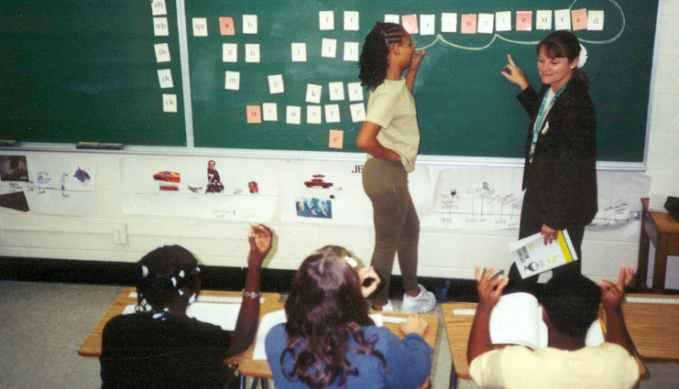
Scheduling WRS Lessons
Students with a diagnosed language-based learning disability or dyslexia or those needing more intensive instruction.
1:1
  2-5 lessons per week
  for 60-90 minutes
Small Group (2-6 students)
  3x per week for 90 min or
  5x per week for 60-90 minutes
(Wilson Certification Recommended)
Notes:
Speaker Notes
Mention minimum number of minutes for group instruction is 45 minutes five days per week – that would allow for 2 – 2.5 full WRS Lessons to be completed in a week. However, the times on the screen are what we know works best and needed to instruct all the parts of the lesson and the aspects of instruction that these students need to be successful.

Slide 59
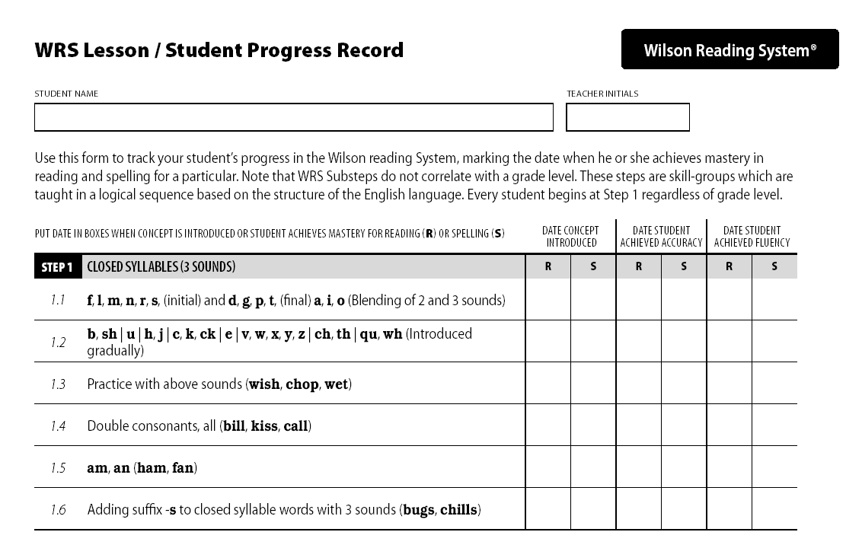
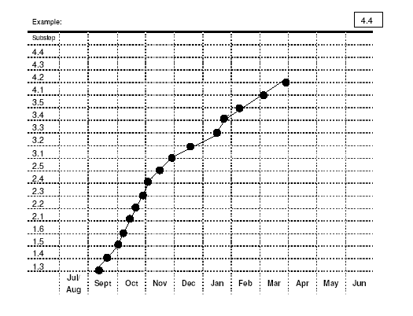
Pacing
It typically takes 2-3 years to complete all twelve WRS Steps, if lessons are scheduled appropriately and occur consistently.
It may take longer than 2-3 years if student is severely dyslexic.
A substantial amount of instruction may need to take place before scores improve on standardized (normed) tests.
Notes:
Speaker Notes:
Students must master concepts, apply skills, develop fluency, and understand text at an increasing level of complexity. Pacing is key! Students need to demonstrate mastery and teachers need to make important instructional decisions about pacing. Guidelines are provided in our instructor materials and professional learning.

Slide 60
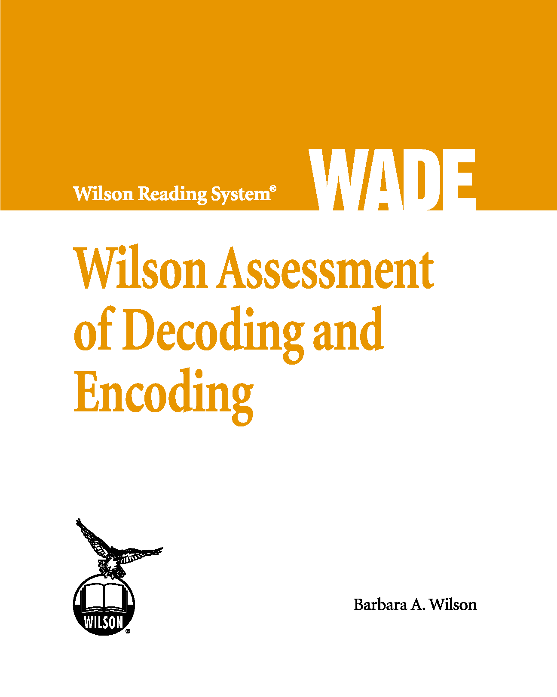
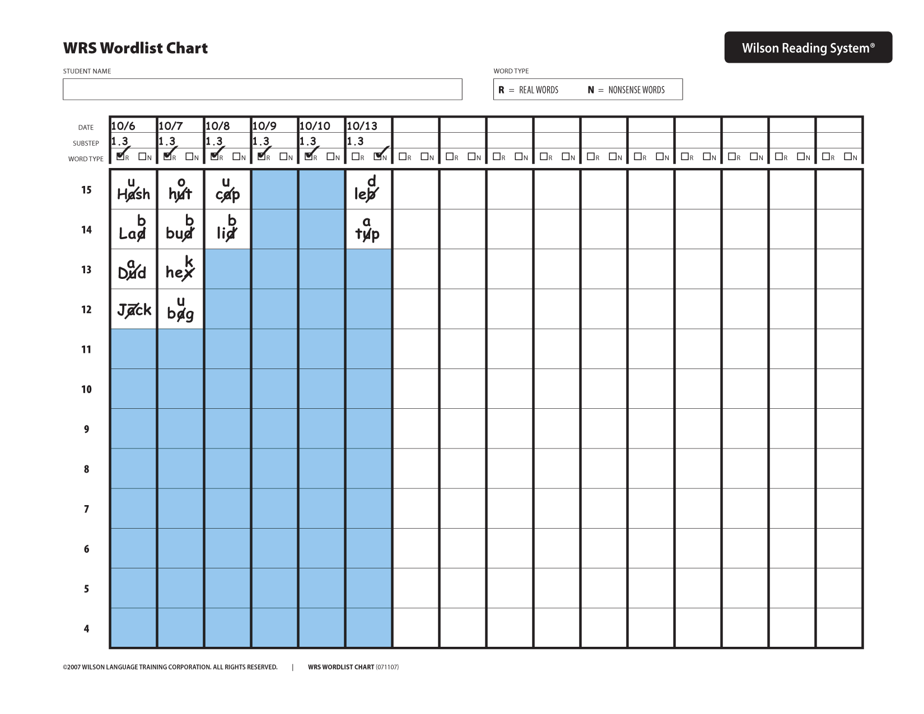
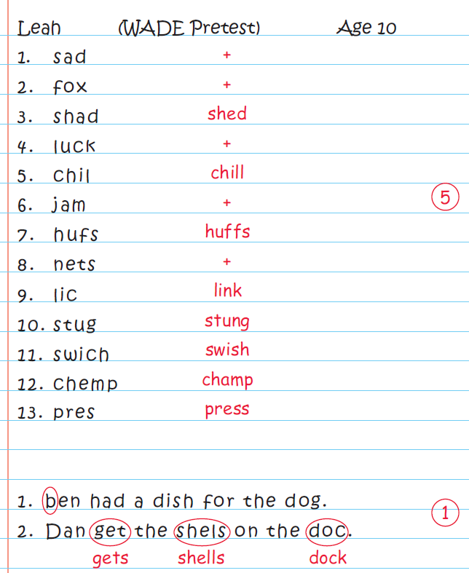
Wilson Reading System: Measuring Progress
Notes:
Speaker Notes
It’s important to measure and track progress of these students and the WRS program offers some “built in” ways to do this.
Measuring progress may involve formative and summative progress monitoring and assessments.
Formative (immediate or short-term instruction goals for particular skills or knowledge) - Could be tests created by teachers, checklists, anecdotal reports, examples of schoolwork, and summative (long-term, comprehensive teaching goals and yields info about the integration of knowledge) - could be a norm-referenced test) data collection.

Slide 61
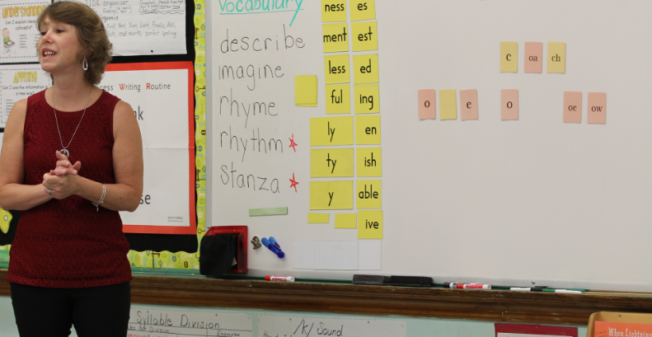
WRS Certification for Teachers
Notes:
Speaker Notes
WLT offers certification for teachers working with students who need this instruction.

Slide 62
Why Certification?
Teacher knowledge is a critical factor for student success.
A highly-skilled Wilson teacher can deliver the program effectively and with integrity.
Each Wilson trainee is expected to acquire a very sophisticated working knowledge of the sound-symbol system of English (phonology) and its structure (morphology), as well as specific diagnostic techniques in teaching reading and spelling. In addition, explicit teaching of fluency, vocabulary, and comprehension must be demonstrated.
Notes:
Speaker Notes
Why is certification important? Discuss each bullet on slide.

Slide 63

Knowledge and Practice Standards for Teachers
https://dyslexiaida.org/knowledge-and-practices/
Notes:
Speaker Notes:
Teachers of reading should familiarize themselves with the IDA’s Knowledge and Practice Standards for Teachers of Reading. They can access these standards for free at the IDA website.
https://dyslexiaida.org/knowledge-and-practices/

Slide 64

WRS Certification - IDA Accredited Tier 3 Program
This designation recognizes that Wilson Reading System Certifications align with the IDA Knowledge and Practice Standards for Teacher of Reading.
Notes:
Speaker Notes:
WRS Certification Programs are accredited by the IDA through a rigorous evaluation process assessing the way we address these Knowledge and Practice Standards.

Slide 65

Council of Administrators of Special Education
The Wilson Reading System has been endorsed by the Council of Administrators of Special Education.
Notes:
Speaker Notes
WRS is also endorsed by the Council of Administrators of Special Education.

Slide 66

WRS Certification
WRS Level I Certification
WRS Introductory Workshop
WRS Intensive Instruction Online Course (Steps 1-6)
WRS Steps 1-6 Practicum
WRS Level II Certification
WRS Advanced Strategies for MSL Group Instruction Workshop
WRS Group Mastery Practicum
WRS Advanced Word Study Online Course (Steps 7-12)
WRS Steps 7-12 Practicum
Notes:
Speaker Notes
Here’s a quick look at the coursework involved in WRS certification.

Slide 67
WRS Introductory Workshop
Three day (15 hour) workshop provides participants with an overview of the Wilson Reading System curriculum. Examines reading research, principles of instruction, dyslexia, appropriate student identification and placement, program implementation, progress monitoring, and multisensory structured language teaching.
Pre-requisite for WRS Level I Certification Training.
Notes:
Speaker Notes
Each WRS Certification Training begins with the WRS Introductory Workshop. Many parents attend the 3 day workshop to have a better understanding of the program.

Slide 68
WRS Level I Certification
WRS Level I Certification
Wilson® Dyslexia Practitioner (W.D.P.)
Training involves extensive online coursework (90 hours) and a year-long supervised practicum (minimum 60 hours)
Prepares teachers to work 1:1 with students in WRS Steps 1 – 6
Notes:
Speaker Notes:
Wilson provides a comprehensive training for teachers using the program.
Explain that the WRS lesson plan is based on continuous assessment of the students’ needs. An important factor for student success is teacher knowledge. Teachers need an in-depth knowledge of the speech sound system and must know how our written language represents spoken English. In addition to language structure, teachers also need to master how to teach using multisensory and diagnostic techniques.
WRS is successful with students who have a language-based learning disability, such as dyslexia, as well as those who are reading below grade level because of word-level deficits.
It is strongly recommended that students who require intensive instruction receive instruction with a highly-skilled WRS teacher.
Level I Certification provides extensive training and support enabling teachers to effectively implement the program with integrity. Certification includes approximately 90 hours of online instruction, a 60-lesson practicum, including demonstration, observation and feedback from a Wilson trainer. The time, effort and study involved with this program are considerable. Each trainee is expected to acquire a very sophisticated working knowledge of the sound-symbol system of English (phonology) and its structure (morphology), as well as the use of specific diagnostic techniques in teaching reading and spelling..
Individuals who successfully meet all requirements of this certification training receive WRS certification (Level I). Level I Certified teachers earn the Wilson Dyslexia Practitioner Credential and must renew this every five years.

Slide 69
WRS Level II Certification
WRS Level II Certification
Wilson® Dyslexia Therapist (W.D.T.)
Training involves extensive seminar and online coursework (70 hours) and two supervised practicum courses (minimum 125 hours)
Prepares teachers to work with small groups of students and in WRS Steps 7-12.
Notes:
Speaker Notes
Wilson also offers an advanced certification program (Level II) to prepare teachers to successfully deliver the program to groups of students, and teach advanced concepts of language structure. Level II Certified teachers earn the Wilson Dyslexia Therapist Credential and must renew this every five years.

Slide 70
Wilson Dyslexia Practitioners & Therapists
Recommending WRS Level I or II Certified teachers is our way of assuring the integrity of the program and that it is being implemented in the way it was designed.
Teachers who have only attended the WRS Introductory Workshop are not considered “trained” in the Wilson Reading System.
Notes:
Speaker Notes
Point out that there is an Introductory Workshop that is a prerequisite for the more in-depth training, but one is not considered trained with the 3 day workshop.

Slide 71
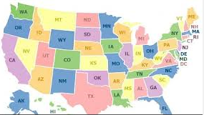

Finding a Wilson® Dyslexia Practitioner or Therapist
Tutor List: 1-800-899-8454
info@wilsonlanguage.com
Notes:
Speaker Notes
WLT can help you or your school find a WRS certified teacher in your area.

Slide 72


Identifying Authentic WRS Instruction
Delivered by qualified instructor, WRS certification strongly recommended
Lessons scheduled appropriately, number of minutes and days per week
1:1 setting or small group (homogenous)
WRS instructional elements evident: student notebook, student composition book, wordlist charting, pre/posttesting with WADE, etc.
m
a
p
Notes:
Speaker Notes
To review, think about these factors when determining if instruction is on track.

Slide 73
Questions to Ask
Did my child’s Wilson teacher complete the Wilson Level I Certification Training? Wilson Level II Certification Training?
How many times per week will my child be receiving Wilson instruction? How many minutes are scheduled for each session?
Will my child be receiving 1:1 instruction or small group (up to 6 students)?
Would it be it be possible to see my child’s Wilson Student Notebook, Wilson Composition Book, and Wordlist Chart, as well as the WADE (Wilson Assessment of Decoding and Encoding) pre and posttesting?
How will you measure my child’s progress?
Notes:
Speaker Notes
Asking the right questions, can help ensure that your child is receiving appropriate instruction with WRS.

Slide 74

www.wilsonlanguage.com
Notes:
Speaker Notes
Our website has a wealth of information about our programs, certification training, and a whole section for parent. Encourage participants to visit!

Slide 75

Program Questions
Wilson Customer Support
1-800-899-8454
info@wilsonlanguage.com
Monday - Friday
Notes:
Speaker Notes
In addition, the WLT staff can assist with any questions they may have. Parents or others may call the 1-800-899-8454 or email info@wilsonlanguage.com for assistance.

Slide 76
W I L S O N L A N G U A G E T R A I N I N G
Achieving Literacy for Life
Never doubt that a small group of committed citizens can change the world. Indeed, it's the only thing that ever has.
~Margaret Mead
Notes:
Speaker Notes:
If time, you may end with a Q & A session or simply thank the audience for attending.

