Slide 1
Dyslexia basics
What Parents and Educators Can Do

Slide 2
University of utah reading clinic
Dr. Kathleen J. Brown
www.uurc.org
801-265-3951

Slide 3
Dyslexia Basics
Dys = abnormal; not in a positive way (Greek)
Lex = word (Greek)
Misconceptions (e.g., see backwards, words jump on the page, colored lenses, marching, eye training)
Core deficit is in language, specifically, the phonological system which causes difficulty matching speech sounds to letter symbols.
Math and oral language abilities normal or above

Slide 4
Dyslexia is…
…a specific learning disability that is neurobiological in origin. It is characterized by difficulties with accurate and/or fluent word recognition and by poor spelling and decoding abilities. These difficulties typically result from a deficit in the phonological component of language that is often unexpected in relation to other cognitive abilities and the provision of effective classroom instruction. Secondary consequences may include problems in reading comprehension and reduced reading experience that can impede growth of vocabulary and background knowledge.

Slide 5
Dyslexia is a specific learning disability that is neurobiological in origin…
This definition has been adopted by:
International Dyslexia Association
National Institute of Child Health & Human Development (US Department of Health & Human Services)

Slide 6
Dyslexia
is not caused by a visual problem
is not caused by lack of motivation
occurs in all socioeconomic levels
occurs slightly more in boys than girls
may occur in spite of good classroom instruction
is resistant to intervention
may occur with other disorders (e.g., ADD)

Slide 7
A Non-Dyslexic Child’s Journey in G1
b d
/b/ /d/
Over time, speech sounds and graphemes processed simultaneously (automaticity). Result? No more mistakes!

Slide 8
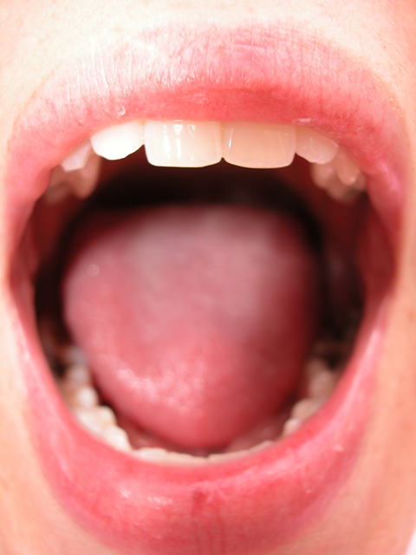
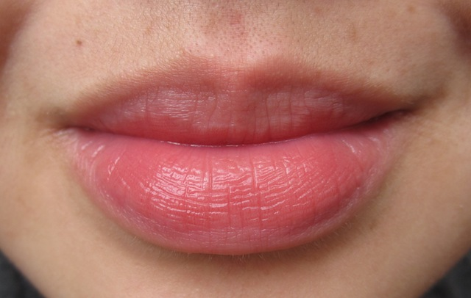
A Dyslexic Child’s Journey in G1 and On
b d
/b/ /d/

Slide 9
A Dyslexic Child’s Journey in G1 and On
what that
/wŭt/ /ðăt/
quit, quiet, quite and, said
ever, every, very ever though, through

Slide 10
What Can Teachers & Parents Do?
Teach Tapping for Reading & Spelling (at the syllable level)
Fully-Analyze Confused High Frequency Words
Sound like _______, but spells like _______.
Repeated Readings - http://www.uurc.utah.edu/General/Forms-Charts.php

Slide 11
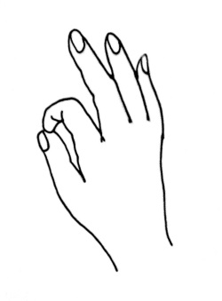
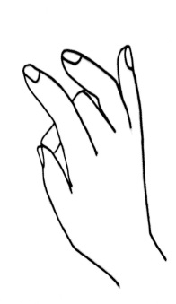

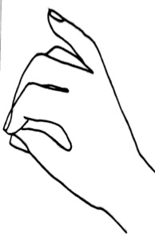
What Can Teachers & Parents Do?
Teach Tapping for Reading & Spelling (at the syllable level)
1. tap forefinger 2. then, middle finger 3. then, ring finger 4. then, all 3 at once
  /s/ /ă/ /d/ /sad/
shrimp; black vs. back; stick vs. sick; quite vs. quit; supplant

Slide 12
What Can Teachers & Parents Do?
Fully-Analyze Confused High Frequency Words
Write 1 Confused High Frequency Word (e.g., said)
  Count letters; count phonemes.
  Make Elkonin Boxes for phonemes.
  Tap to identify letters for sounds & write in boxes.
  Re-analyze as needed.
Practice 2-2-2 with that word.

Slide 13
What Can a Parent Do at Home?
Home Word Charts - http://www.uurc.utah.edu/General/HomeWord.php
Repeated Readings - http://www.uurc.utah.edu/General/Forms-Charts.php
More, more, and more! http://www.uurc.utah.edu/Parents/ParentLinks.php

Slide 14
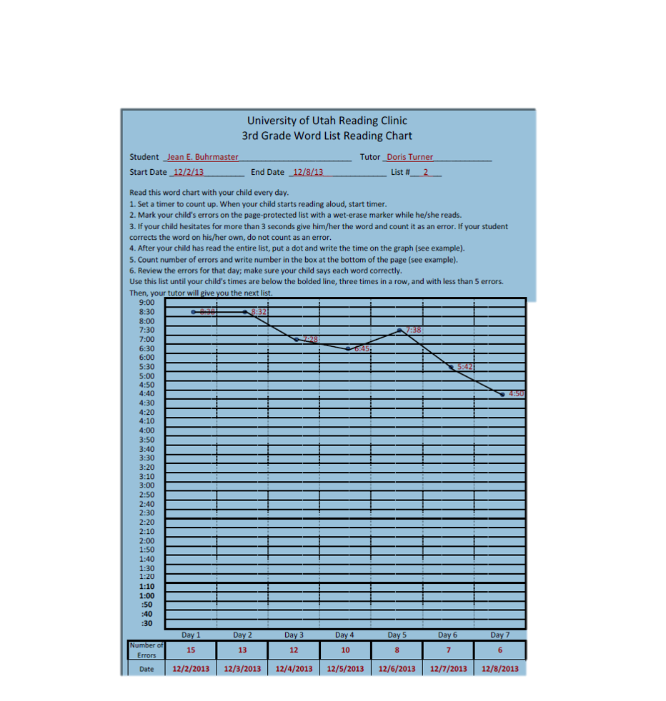

Slide 15
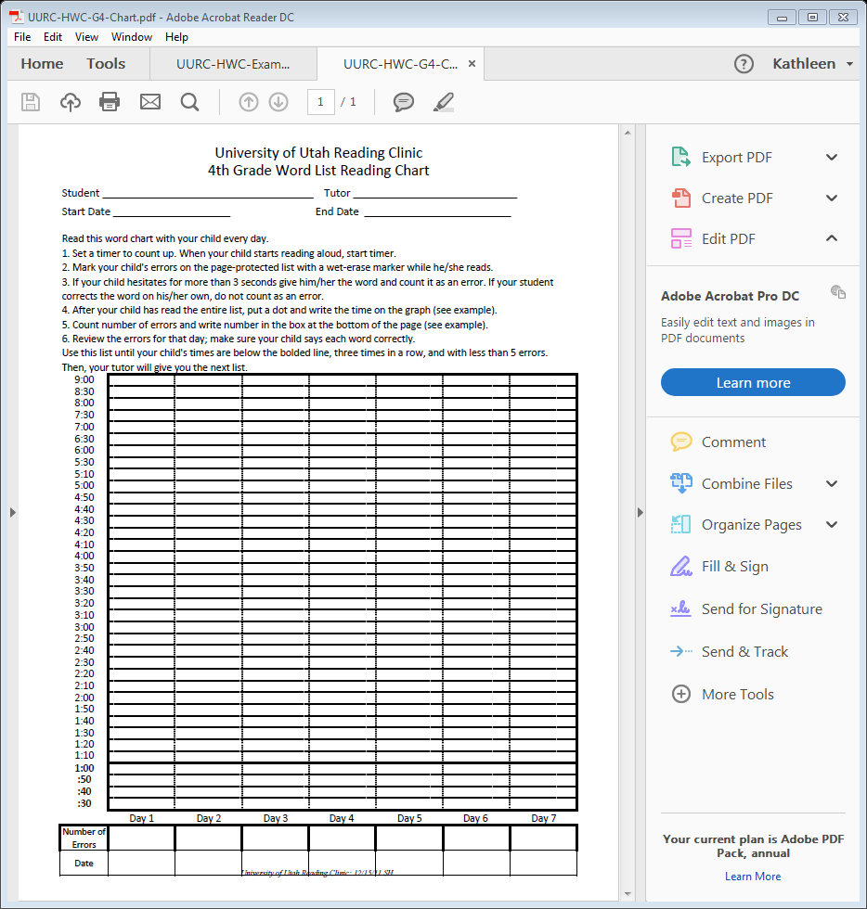

Slide 16
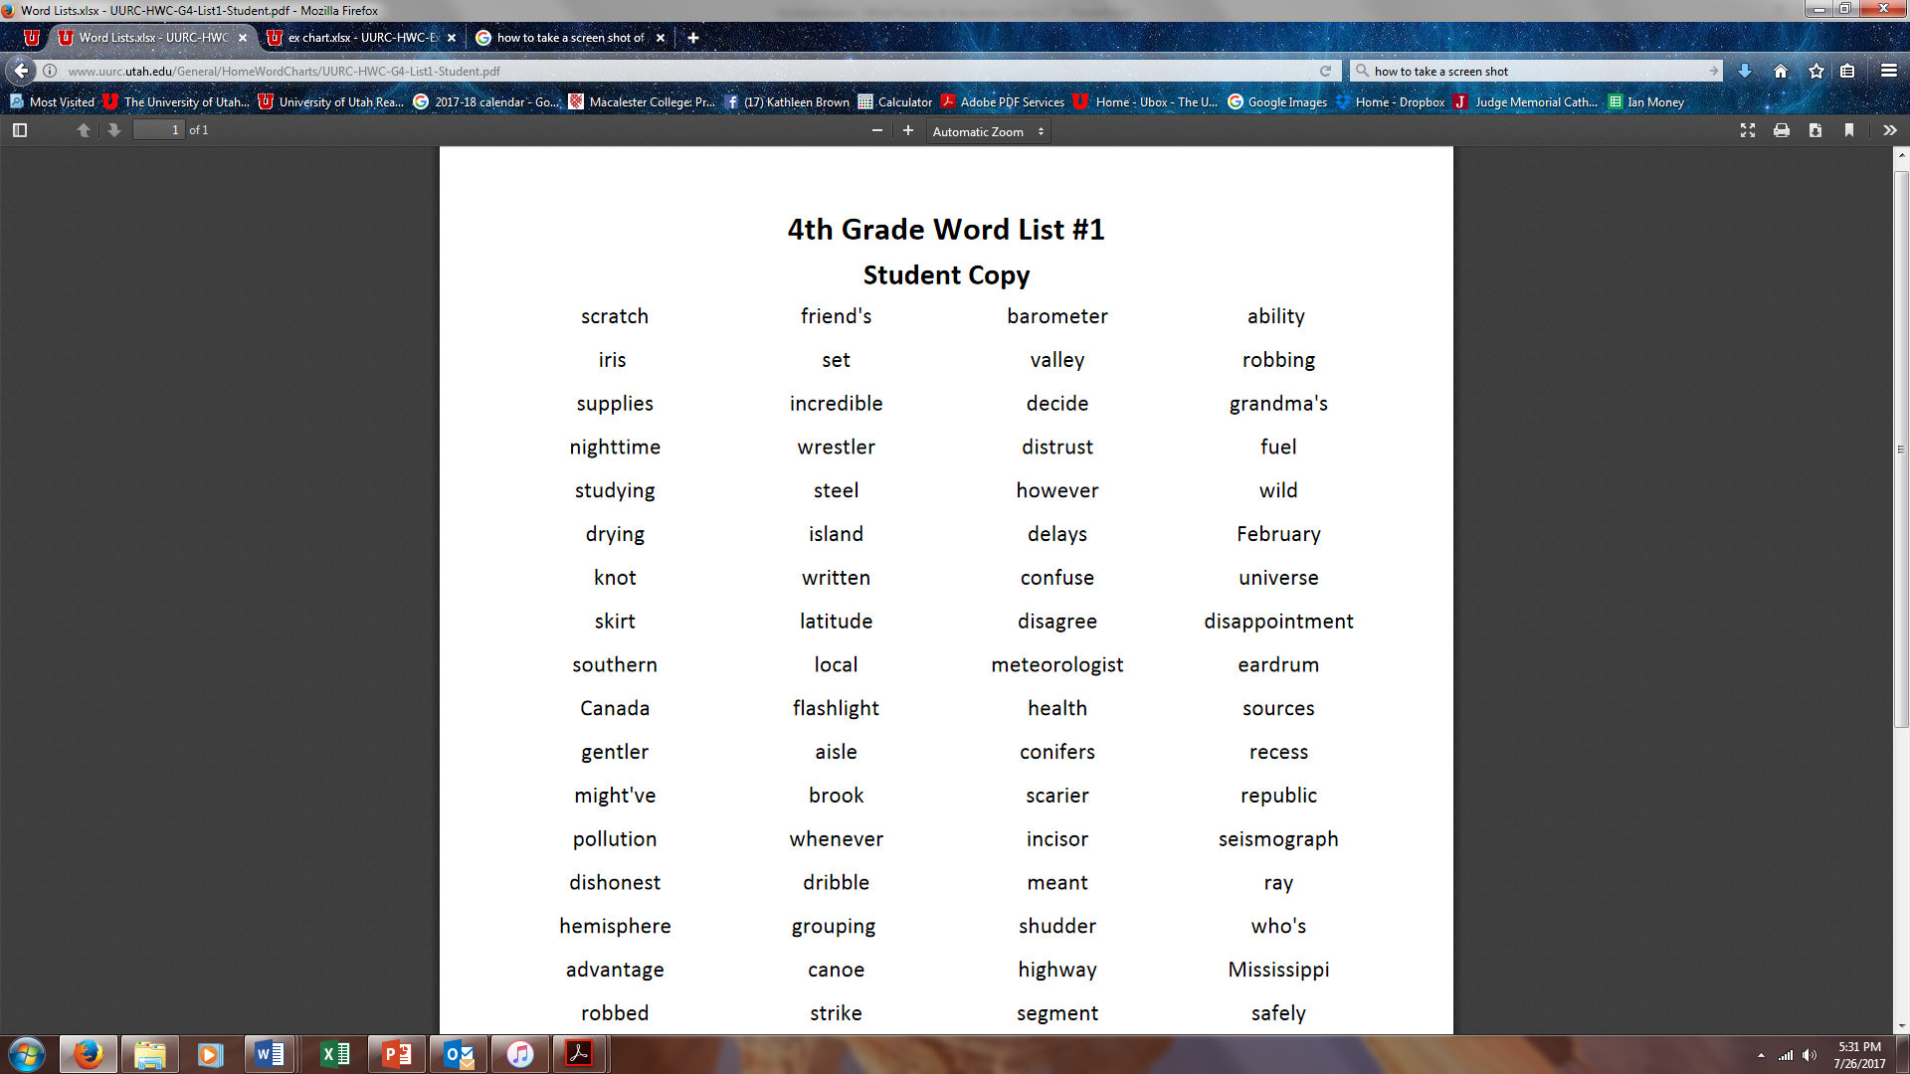

Slide 18
Students Who Do Not Qualify for an IEP
For students with moderate reading difficulties who do not have IEPs, and who are unlikely to qualify for an IEP, a 504 Plan can be a life-saver!
A 504 Plan will allow accommodations that help a junior high/high school student to keep up with coursework and demonstrate optimum performance on standardized tests (e.g., ACT)
Teachers need to be in the 504 “loop” for the plan to work well. A 504 Plan is not “cheating!”

Slide 19
UURC Services
Basic Assessment Battery - $50
Intensive Assessment Battery - $100
      after intervention
Basic Intervention - 45 minutes 2x week
Intensive Intervention (Wilson) - 75 minutes 2x week
Professional Development for Educators (basic, intensive intervention)

Slide 20
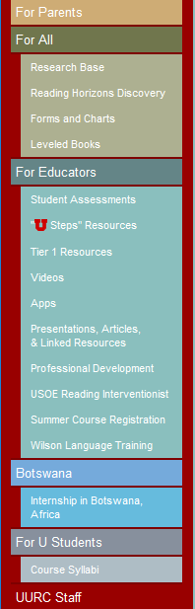
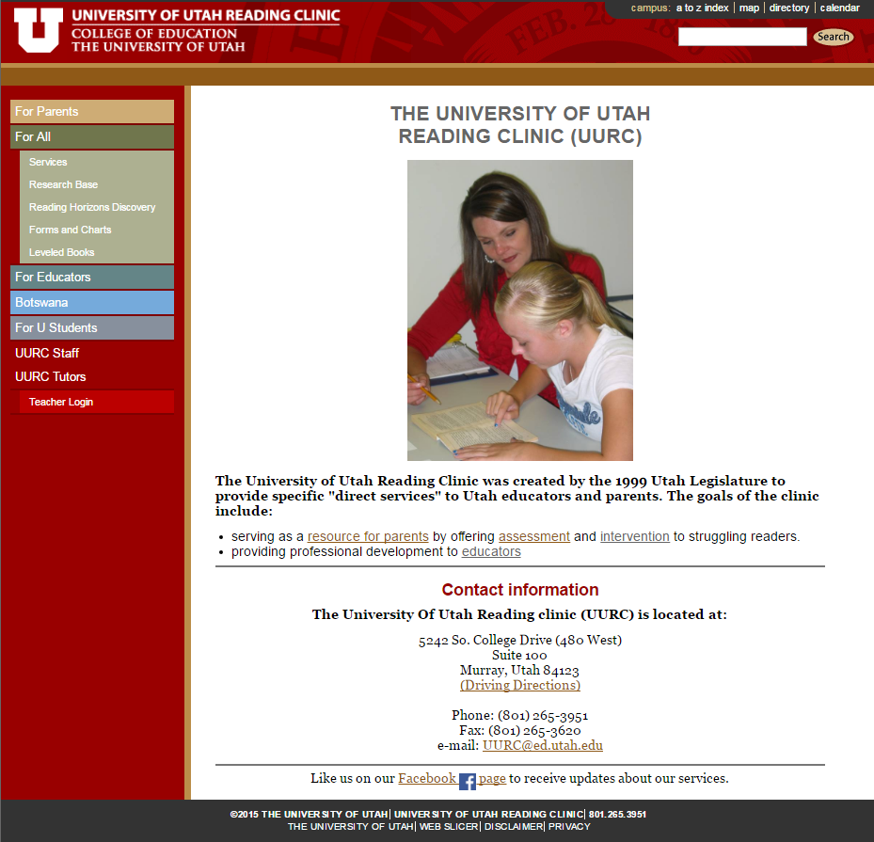

www.uurc.utah.edu

Slide 21

For More Information
The International
Dyslexia Association
40 York Road
4th Floor
Baltimore, Maryland 21204
www.interdys.org
1-800-ABCD123
410-296-0232

