Slide 1
Neutralizing Pendulum Swings: What Reading Teachers Can do
Dr. Kathleen J. Brown, University of Utah Reading Clinic www.uurc.org

Slide 2
With Heartfelt Thanks to:
Jan Dole
Gale Sinatra
Ralph Reynolds
Darrell Morris
Steve Stahl
Louisa Moats
Linnea Ehri
Keith Stanovich
The UURC Staff

Slide 3
With Sincere Apologies to:
fluency research & instruction
writing (composition) research & instruction

Slide 4
Before the Pendulum Swings
Reading C&I informed by esteemed Higher Ed profs via basal program publishers
Whole word a.k.a. Look-Say method (1930 – 1985)
William S. Gray → Scott Foresman
Odille Ousley & David H Russell → Ginn
Reading clinics at universities for Master’s Degree educators
But! Reading C&I not studied with scientific method until early 1960s

Slide 5
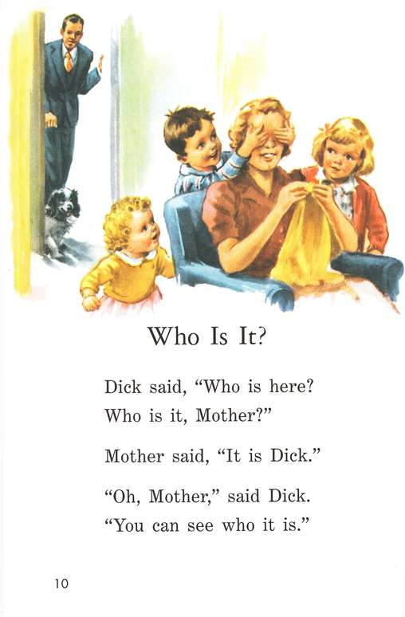
Grosset & Dunlop, 2004

Slide 6
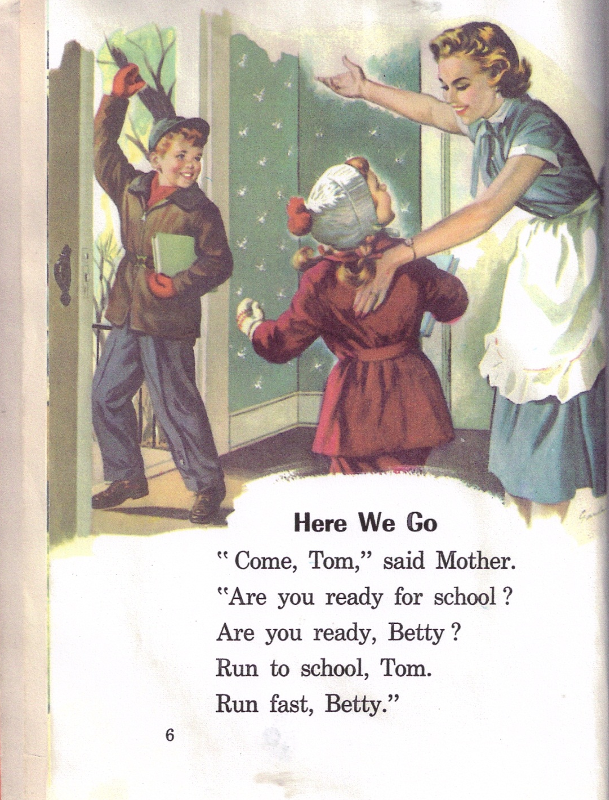

Slide 7
Why Extreme Pendulum Swings?
Large number of struggling readers (14th of 34th in world)
Parents, policy-makers & elected officials look for answers
Higher Ed community lacks consensus (progressives vs. psychologists) → weakens teacher preparation
Public Ed community lacks consensus
Policy-makers, elected officials, & publishers step into the vacuum

Slide 8
Result: Pendulum Swings in Policy
Why Johnny Can’t Read, by Flesch (1955)
Learning to Read: The Great Debate, by Chall (1967)
The 1st Grade Studies, by Bond & Dykstra (1967)
A Nation at Risk (1983)
Becoming a Nation of Readers, by Anderson (1985)
Whole Language Framework in California (1987)
Beginning to Read: Thinking & Learning About Print by Adams (1990)
California’s scores on NAEP (1993, 1996)
Re-enter Skills Curriculum in California (1995)
Preventing Reading Difficulties in Young Children by Snow et al. (1998)
Reading Excellence Act (1998)
National Reading Panel (2000)
NCLB & Reading First (2001)
Utah SB 150 (2010)

Slide 9
Result: Pendulum Swings in Curriculum
Baseline = “Dick and Jane” Basal Programs (Ginn & Scott Foresman)
Sullivan, Lipincott, SRA Synthetic Phonics Programs
Guided Reading w/tubs of predictable little books and/or Literature Anthologies
Post-1997 Core Programs = literature & controlled text (Open Court, Harcourt, Houghton-Mifflin, Scott Foresman, Macmillan)
2012 = More of the same w/goal of being everything to everybody (ELL, Tier II intervention, G&T)

Slide 10
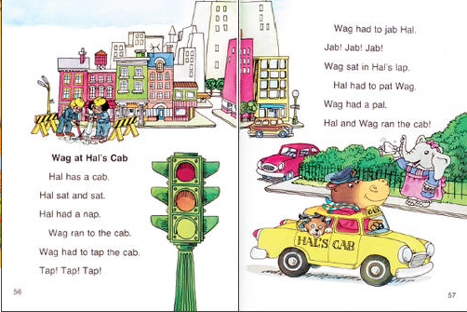
McGraw Hill Education

Slide 11
Wright Group

Slide 12
Truth within the Swings
Reading is an interactive process of constructing a mental model of meaning from print & background knowledge.
The reading educator’s teaching skill matters---a great deal!
Systematic, explicit phonics is necessary in primary grades.
Reading Rate (speed) and Vocabulary are the most important predictors of reading ability .
Classrooms need lots of interesting books from multiple genres.
Reading and writing C&I can and should inform each other.

Slide 13
Have We Made Any Progress in Utah?
Utah 4th graders ‘below basic’ in 1992 = 33%
Utah 4th grades ‘below basic’ in 2011 = 34%
Some schools have made measurable, significant progress
Some schools continue to use ineffective, inefficient reading instruction (round robin, tubs o’ books)

Slide 14
Avoiding the Extreme Swings: Knowledge
about what constitutes real scientific evidence vs. anecdotes & quotations
about the reading process as executed by experts (especially the roles of word recognition, background knowledge, & vocab)
about reading development—especially the ability to read words (from nonreader to expert)
about the features of text difficulty (# of words on page, orthographic complexity, number of unique and/or new words)
scope and sequence of
Phonological awareness
Phonics

Slide 15
Avoiding the Extreme Swings: Skill
how to build students’ background knowledge for text
how to determine each student’s instructional level (from nonreader to expert)
how to place & pace students in LOTS of CONNECTED TEXT of increasing difficulty
how to place & pace students in WORD STUDY INSTRUCTION
Phonological awareness, Phonics, Spelling, Vocabulary

Slide 16
Reading Comprehension Theory
Reading comprehension is influenced by word recognition skill, background knowledge (concepts & vocab), inference skill, monitoring skill, and motivation.
Anderson (1977) Schema Theory
Kintsch (1978 - 2005) Construction-Integration Theory
Van Oostendorp & Goldman (1999) Automatic & Strategic
Durkin (1978-79) Can’t Get No Comprehension Instruction
RAND Report (2002) Synthesis of Research
Cain & Oakhill (2007) Poor Readers w/Only Poor Comp (10%)
Beck & McKeown (1983 – 2006) Robust Vocab Instruction
Guthrie & Wigfield (1997) Motivation is Important

Slide 17
Reading Comprehension Instruction
use simple, but powerful routines to make text accessible:
Asking Comprehension Questions that Interrogate the Text
Reading Text Aloud to Students, interspersed with Comprehension Work
Echo Reading, interspersed with Comprehension Work
Partner Reading with Every Student Always on Task
Semantic Webs/Plot Diagrams → Written Summaries
select high utility words & provide multiple, meaningful interactions
use academic vocabulary during instruction (e.g., plot, conflict, main character, compare, contrast, theme) & expect students to use this vocabulary (you’ll need to model)

Slide 18
Word Recognition Automaticity Theory
Due to limited cognitive capacity, word reading must be effortless (accurate & fast) for optimum comprehension.
Laberge & Samuels (1974) Automatic Information Processing
Perfetti & Lesgold (1979) Verbal Efficiency Theory
Rayner & Pollatsek (1989) Eye Movements in Reading
Ehri (1979 - 2005) Word Recognition Development
Share & Jorm (1987) Self-Teaching Model
Logan (1997) Instance Theory

Slide 19
Word Recognition Automaticity Instruction
recognize what aspects of word study your current program does well and where the holes are
know how to plug the holes (e.g., UURC Word Study, Words Their Way, Discover Intensive Phonics)
know where your students are in Word Study Development (Alphabet? 1 syllable vowel patterns? Polysyllabic words?)
use simple but powerful instructional routines to ensure that your students develop automaticity
explicit intro teaching → accuracy activities → fluency activities

Slide 20
Assessment Theory & Instruction
instructional level is the highest level where student meets or exceeds accuracy AND rate criteria: KNOW THE CRITERIA!
leave comprehension out of placement decisions and put it in classroom text decisions where it belongs
most students do not need a full diagnostic battery (only Tier 3) a.k.a. stop weighing the pig so much!
see www.uurc.org for a valid, reliable, quick, e-z to use, free instructional level instrument (ERI for K and early G1; RLA for G1-G8) and instructional level criteria

Slide 21
Pendulum-Resistant Educators
Higher Ed AND District In-Service: provides pre-service and practicing teachers with current, scientifically-based theory & instruction
Provide teacher candidates with clinical practica in reading instruction/intervention covering the full range of reading development
Provide practicing educators with the same with a strong focus on Tier I and Tier II as executed in the classroom

Slide 22
Pendulum-Resistant Materials: Text
text of many genre at grade level & instructional levels
clear criteria for placing & pacing (accuracy & rate; not comp)
Questioning the Author (Beck & McKeown, 2006)
Bringing Words to Life (Beck & McKeown & Kucan, 2002)
Basic—repeat—basic comprehension strategy instruction
retelling → summarizing
inferencing
determining importance (narrative & expository differ here!)
monitoring & trouble-shooting comprehension

Slide 23
Pendulum Resistant-Materials: Word Study
clear criteria for placing & pacing (above G1, set a 92% criterion for # words read in 1 minute)
Words Their Way (Bear, Invernizzi, Templeman & Johnson, 2011)
Wilson Fundations (K-3 p.a., phonics, spelling, handwriting) www.fundations.com
Early Reading Intervention for K www.pearsonschool.com
Discover Intensive Phonics www.readinghorizons.com
www.uurc.org (click on Educator and Parent links)

